Slide 1
St. Louis Central Corridor West Building Permits
Yearly Report: 2020

Slide 2
Introduction
Data retreived from https://www.stlouis-mo.gov/data/
Building permits with a cost of $0 were dropped
Building permits that were cancelled were dropped

Slide 3
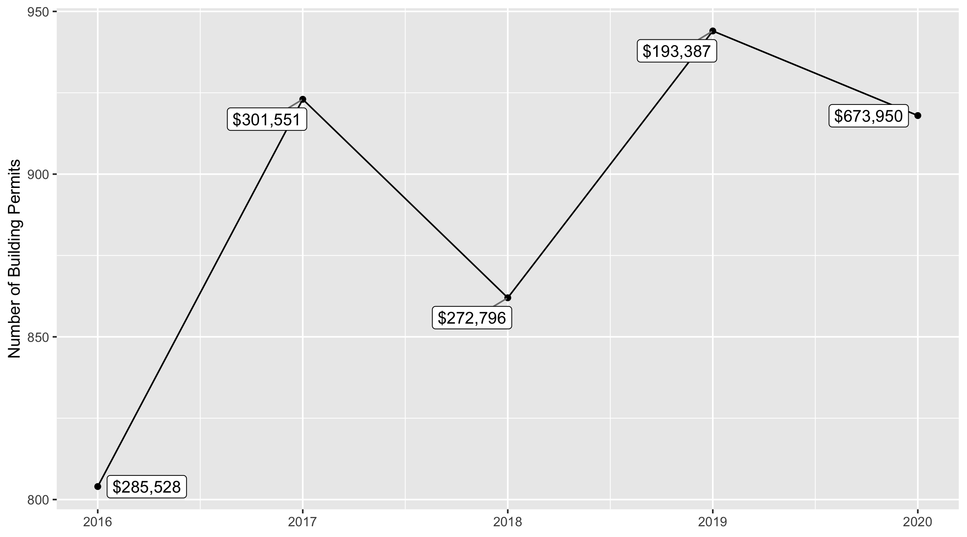
5 Year Analysis

Slide 4
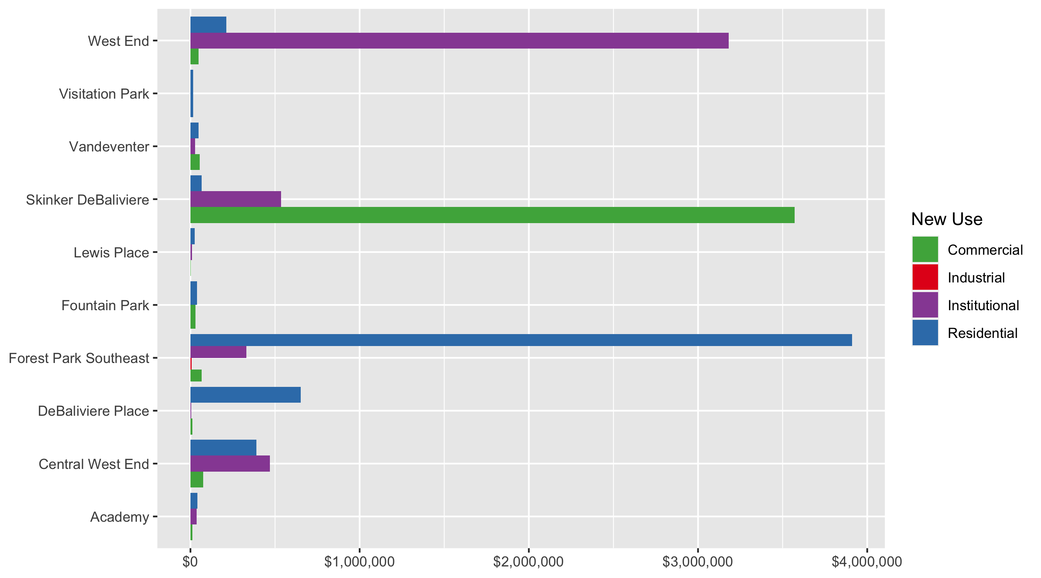
Neighborhood Summary: Average Building Permit Cost

Slide 5
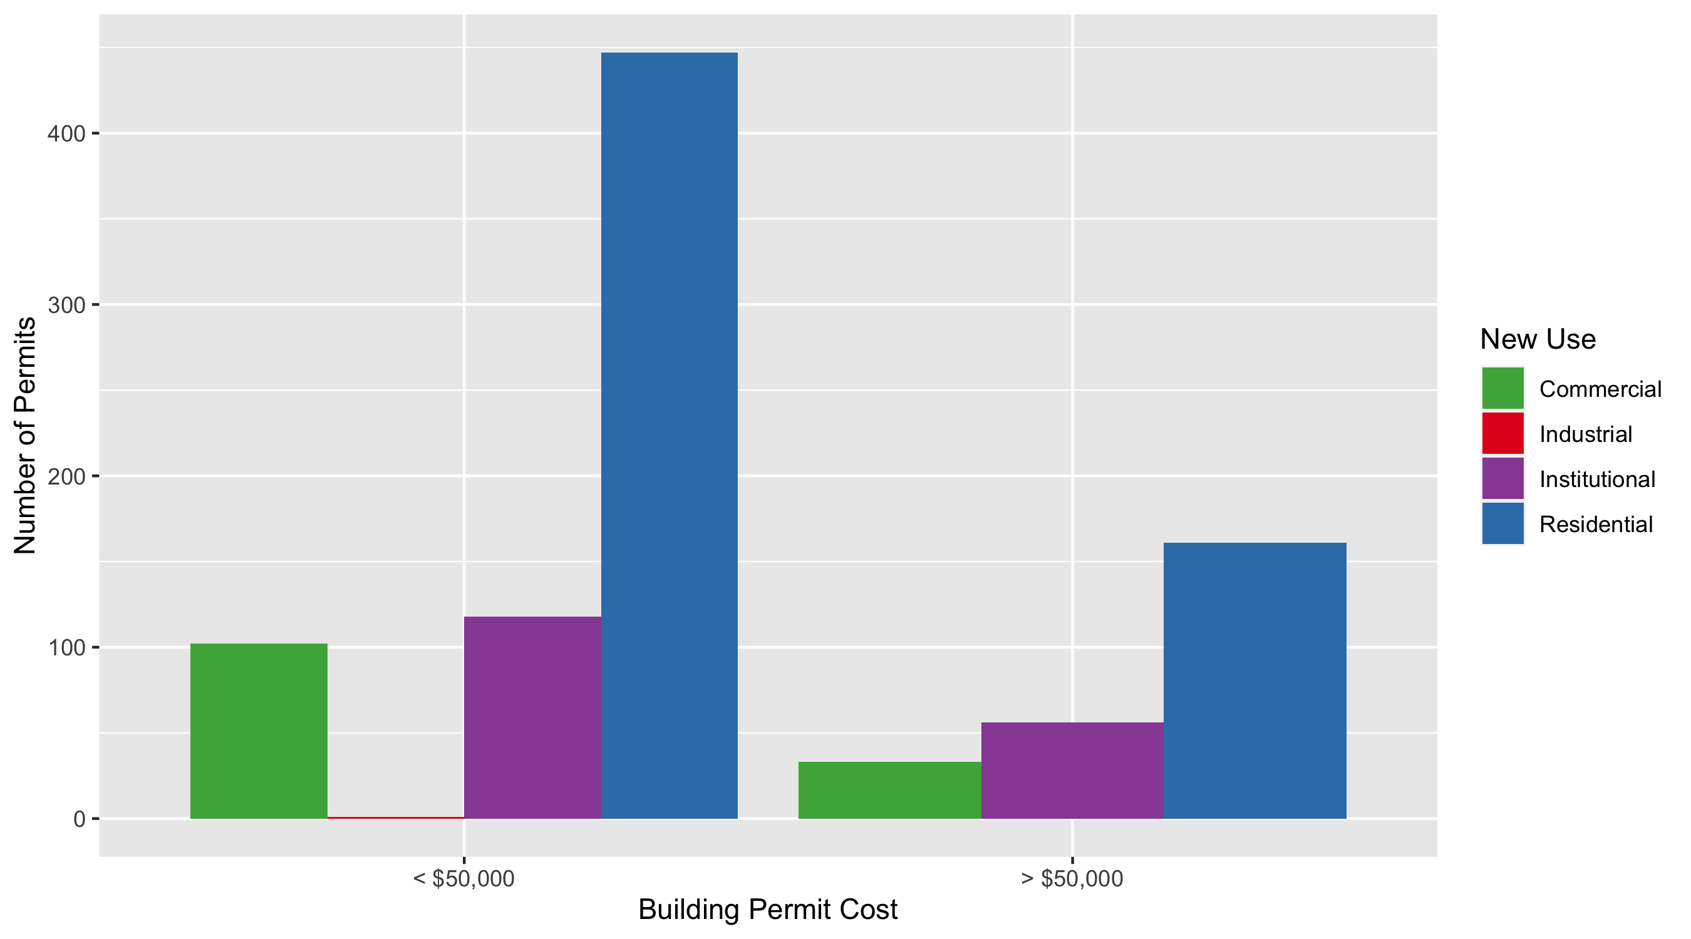
Neighborhood Summary: Average Building Permit Cost

Slide 6
Neighborhood Summary
Neighborhood | Average Cost | # of Permits
Academy | $38,837 | 47
Central West End | $366,177 | 431
DeBaliviere Place | $576,828 | 60
Forest Park Southeast | $2,691,675 | 123
Fountain Park | $38,083 | 6
Lewis Place | $21,206 | 19
Skinker DeBaliviere | $544,001 | 124
Vandeventer | $43,847 | 16
Visitation Park | $14,966 | 8
West End | $291,000 | 84

Slide 7
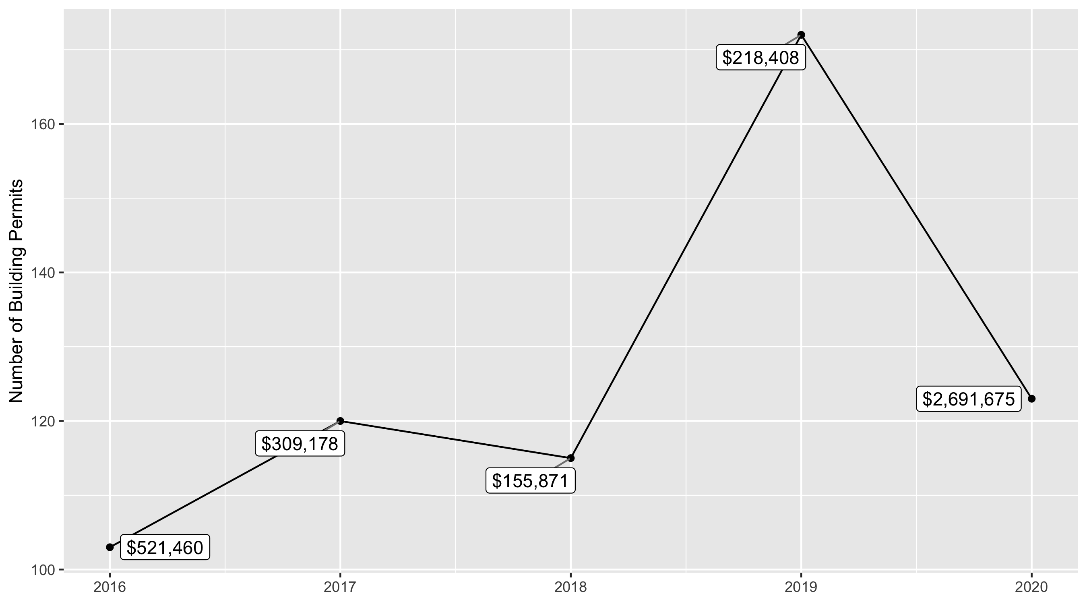
Forest Park Southeast 5 Year Analysis

Slide 8
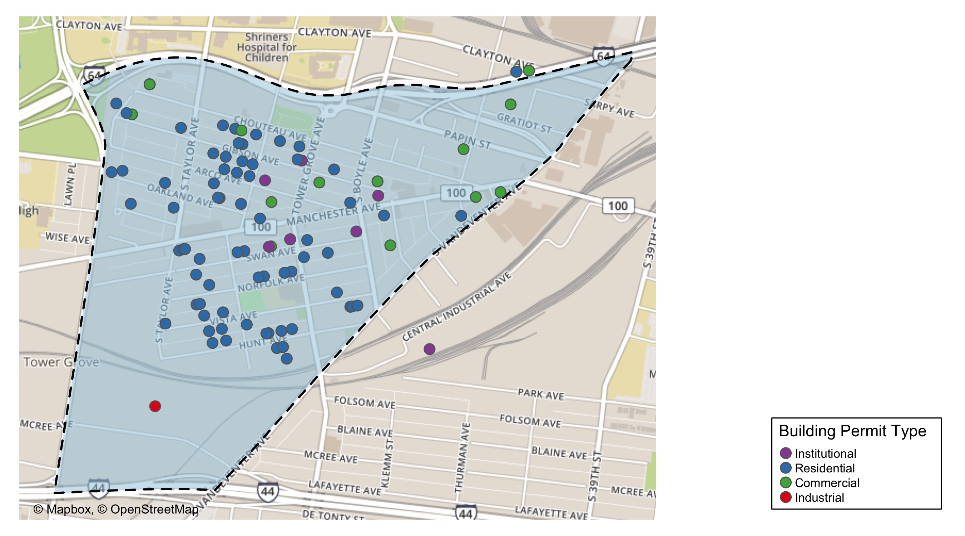
Forest Park Southeast

Slide 9
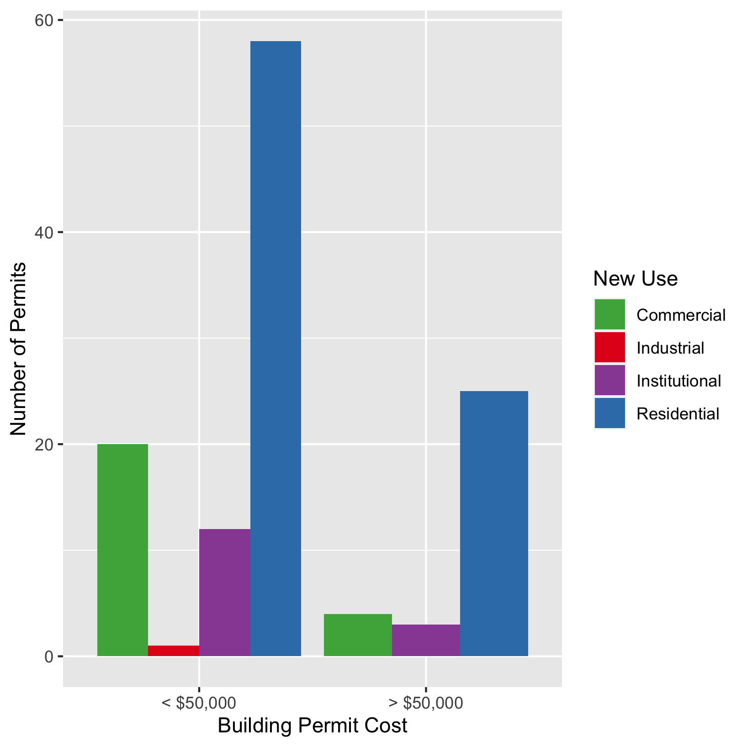
Forest Park Southeast
New Use | Average Cost | # of Permits
Commercial | $66,625 | 24
Industrial | $6,100 | 1
Institutional | $331,329 | 15
Residential | $3,909,650 | 83

Slide 10
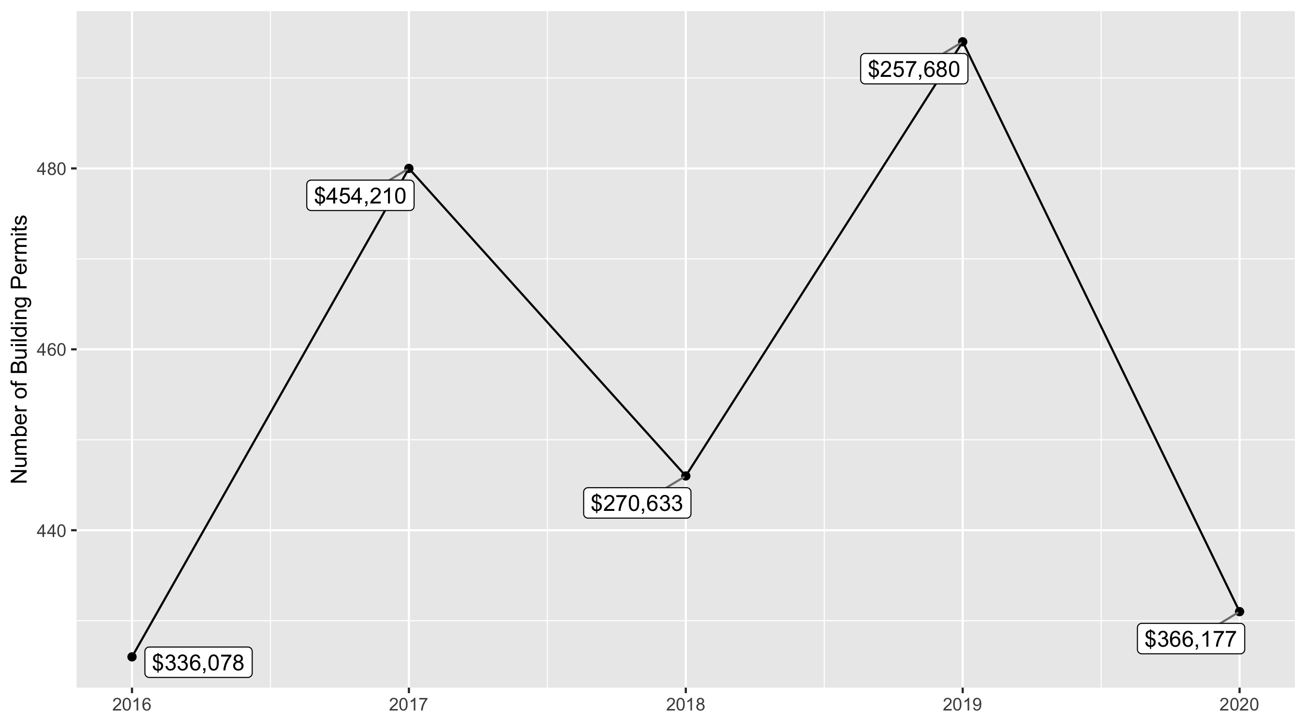
Central West End 5 Year Analysis

Slide 11
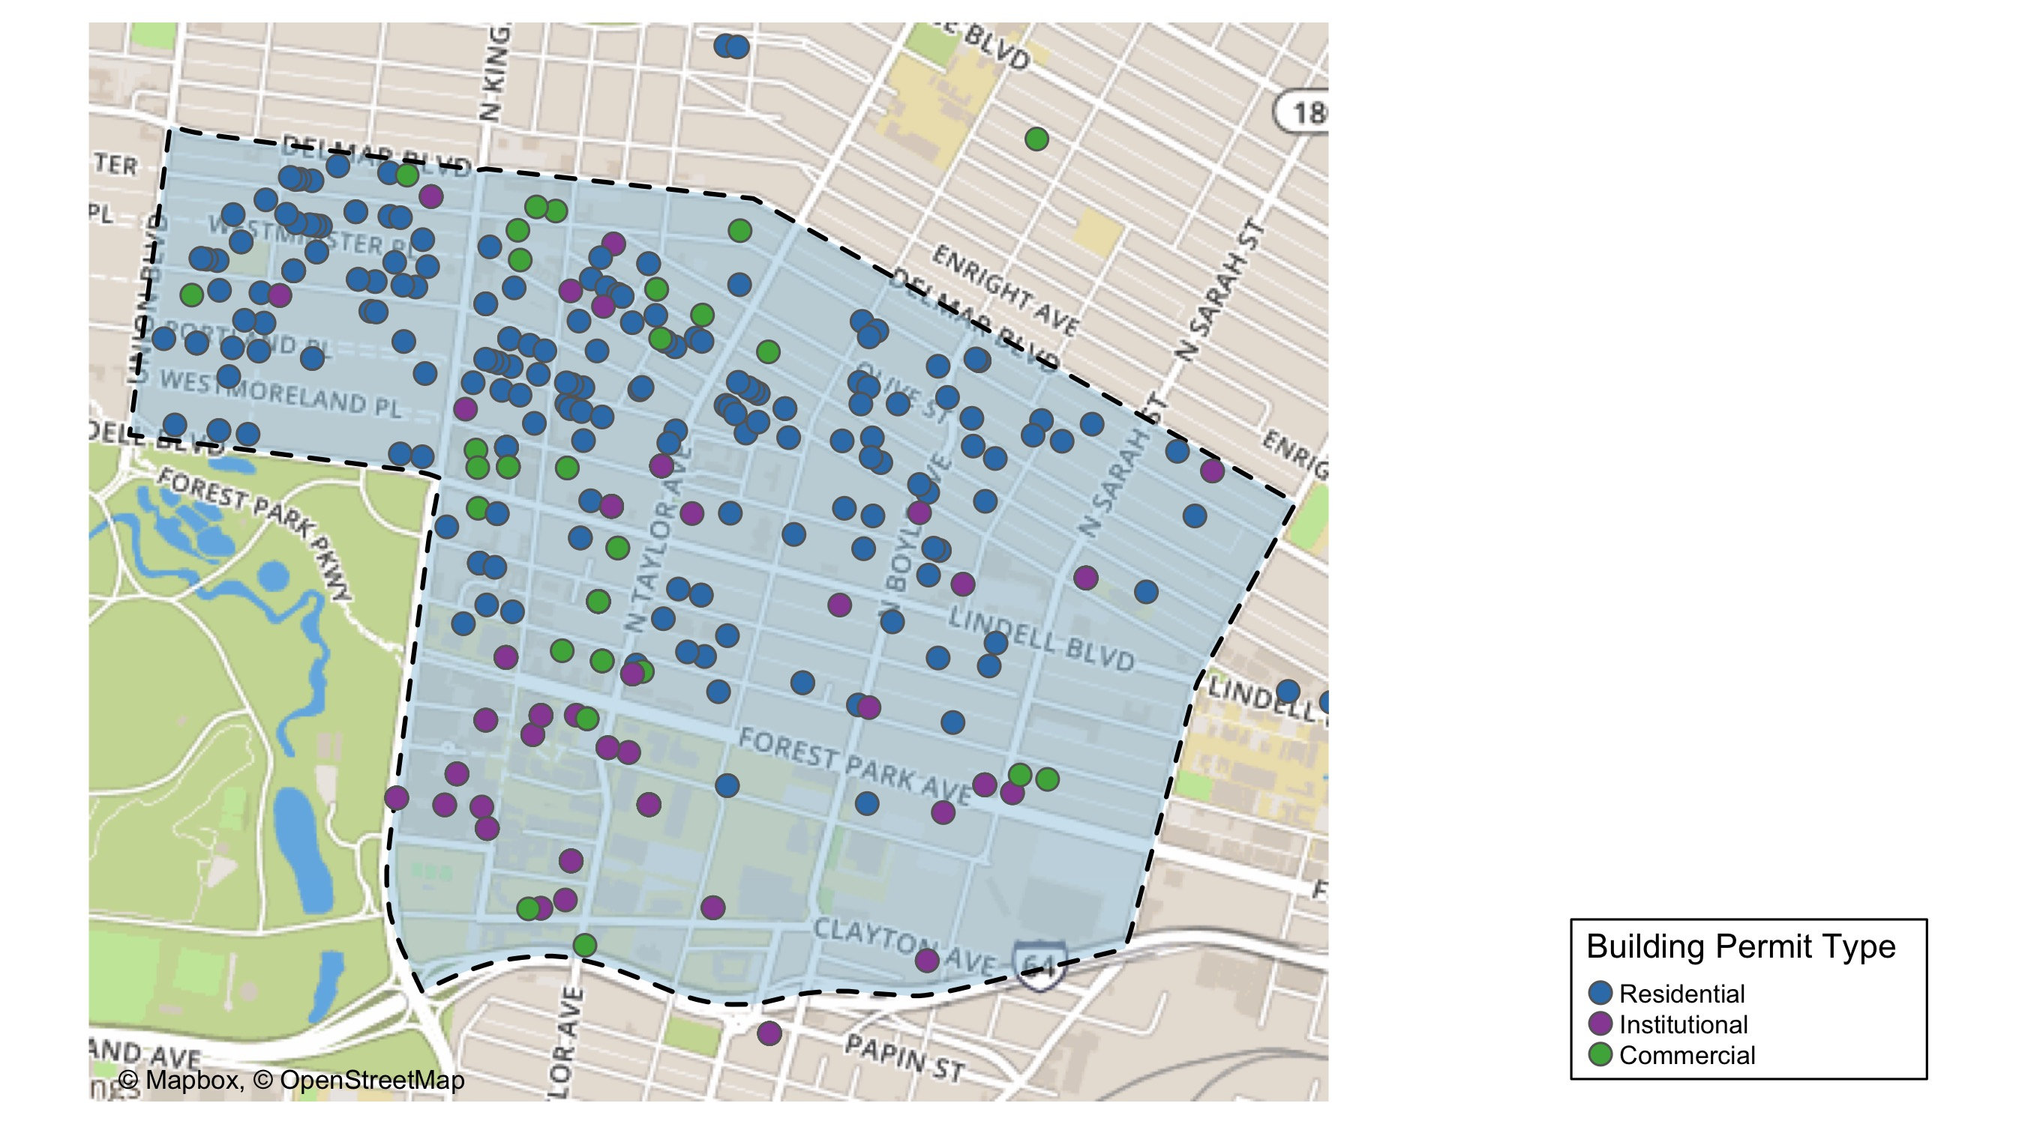
Central West End

Slide 12
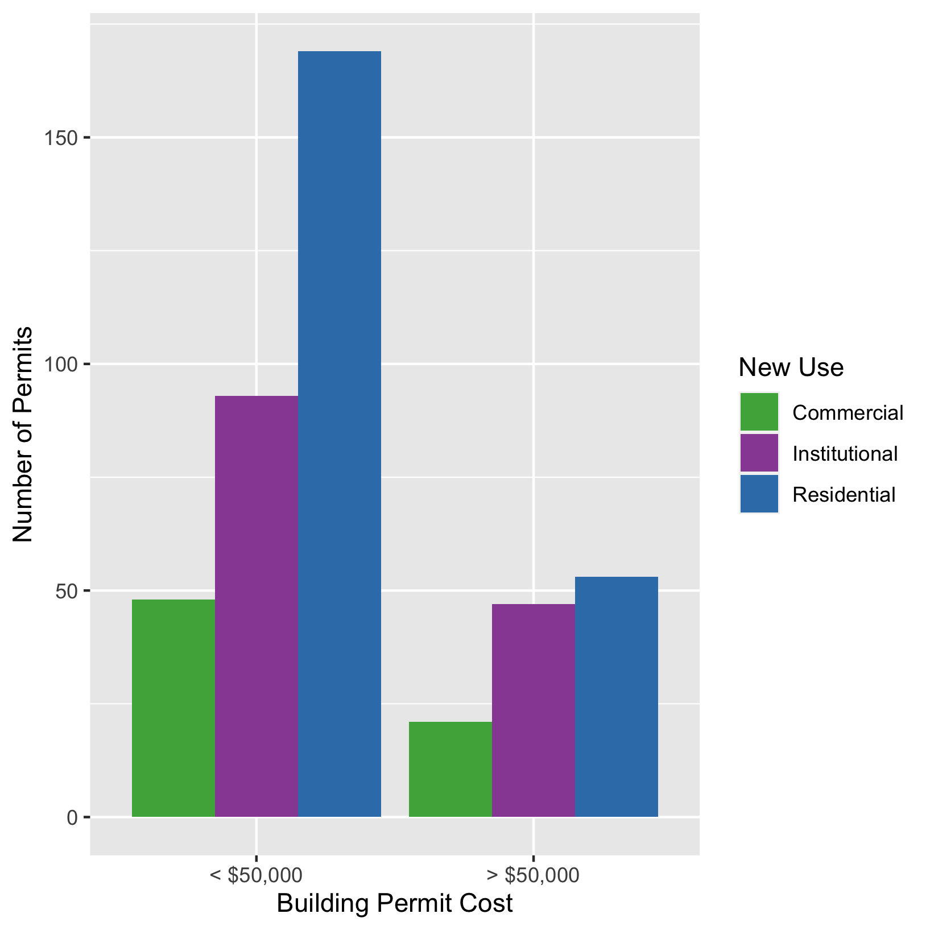
Central West End
New Use | Average Cost | # of Permits
Commercial | $76,330 | 69
Institutional | $470,109 | 140
Residential | $390,722 | 222

Slide 13
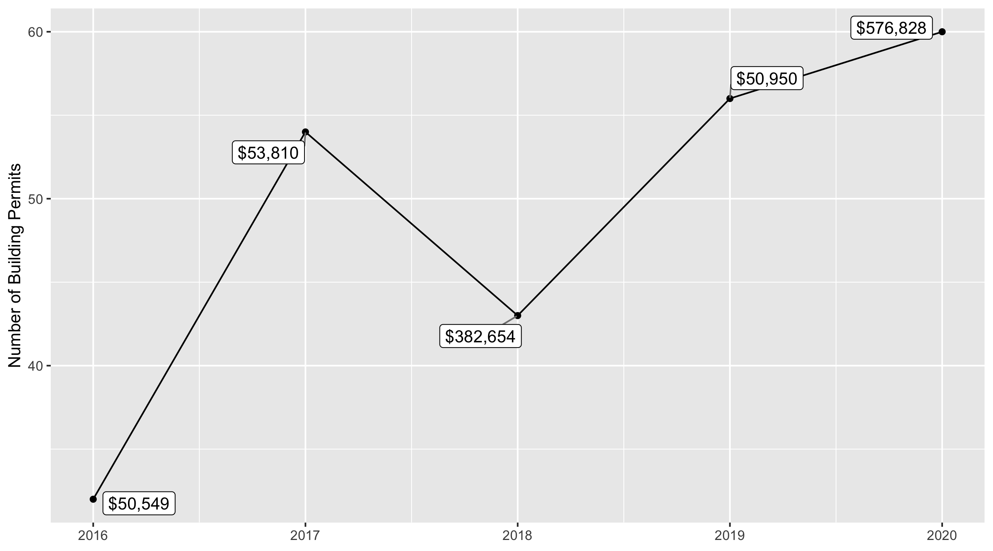
DeBaliviere Place 5 Year Analysis

Slide 14
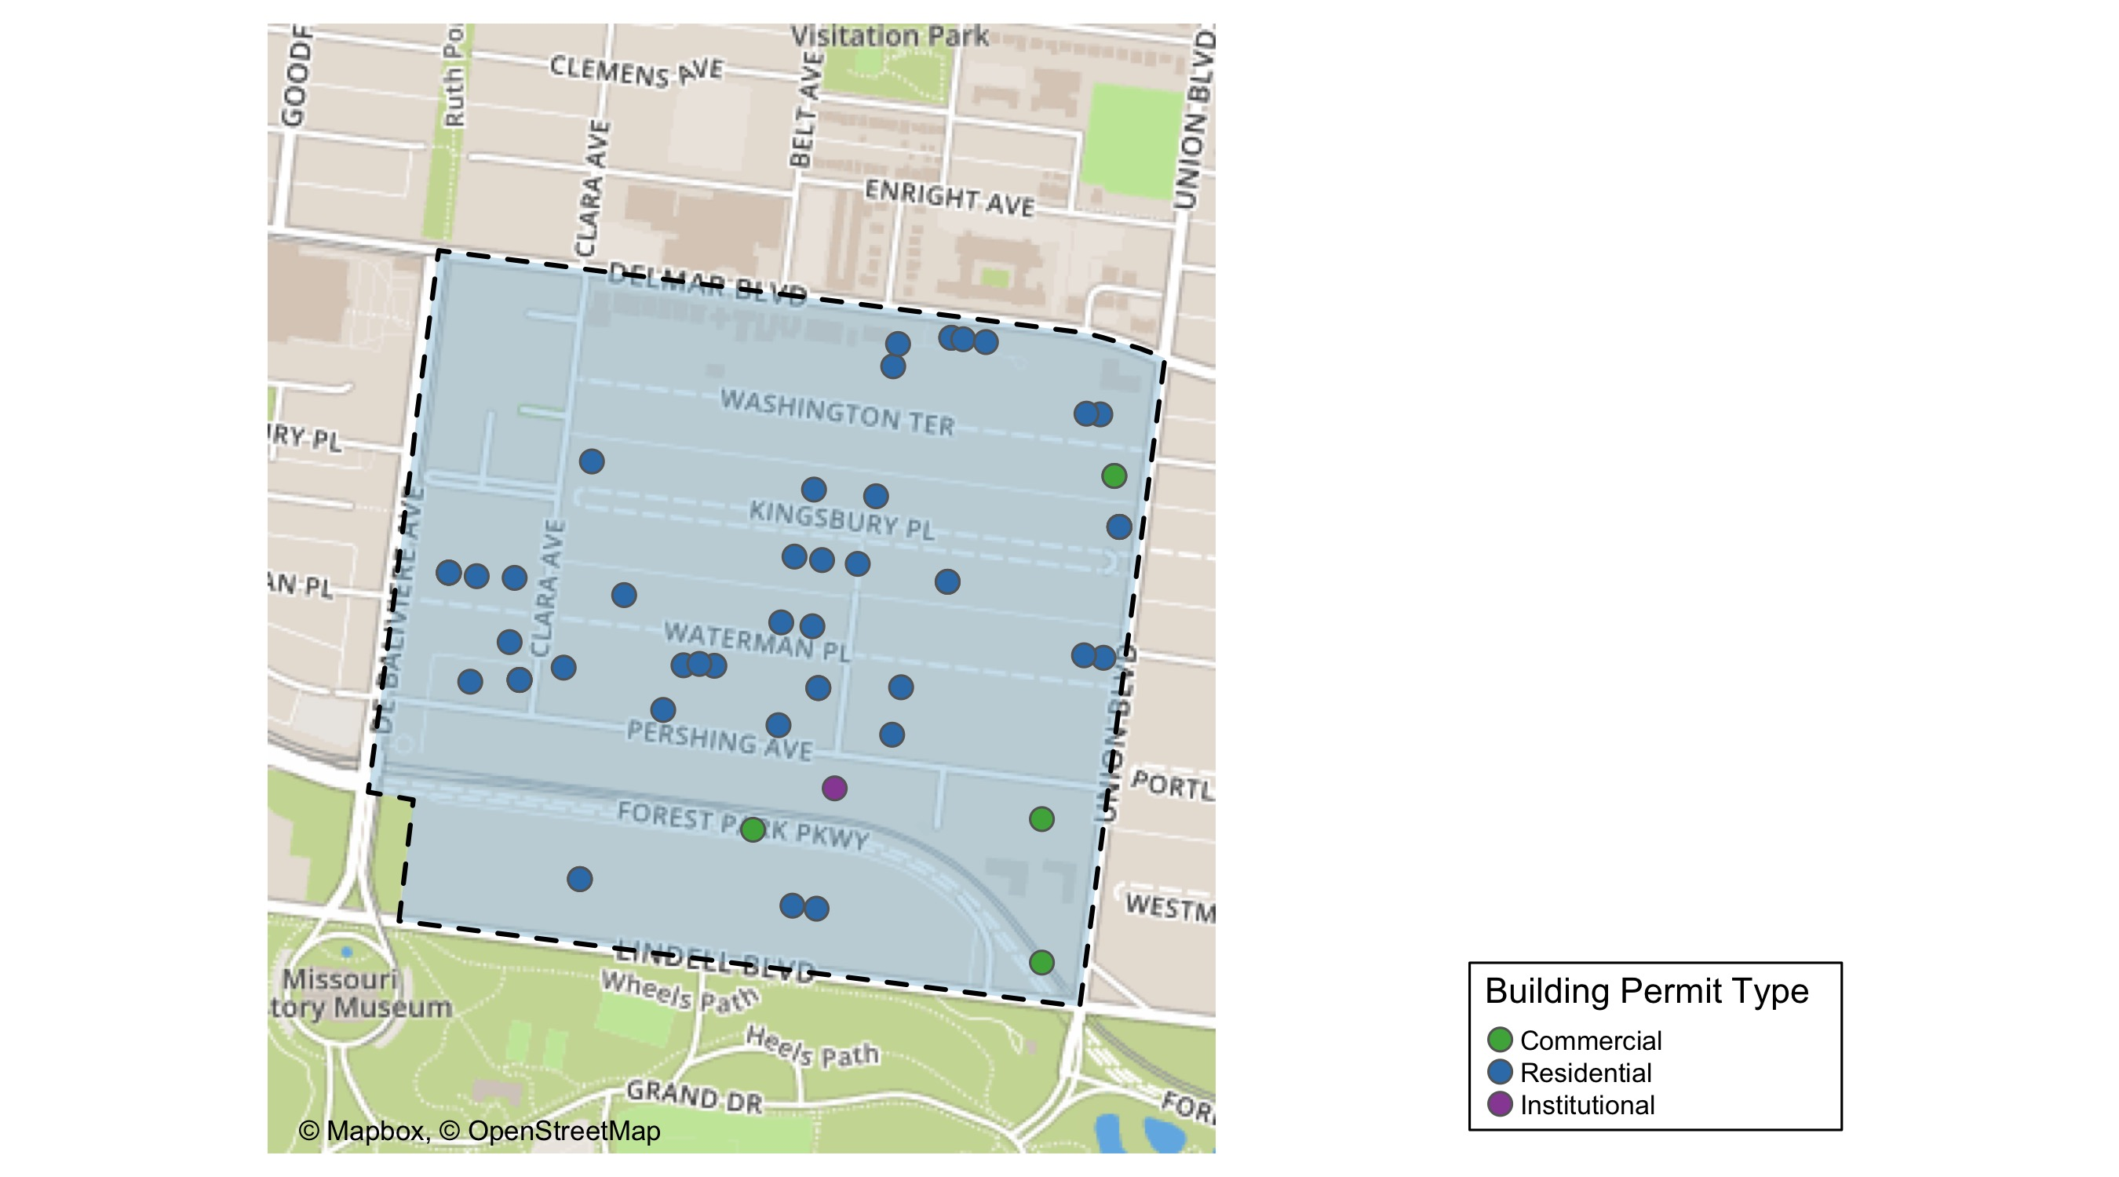
DeBaliviere Place

Slide 15
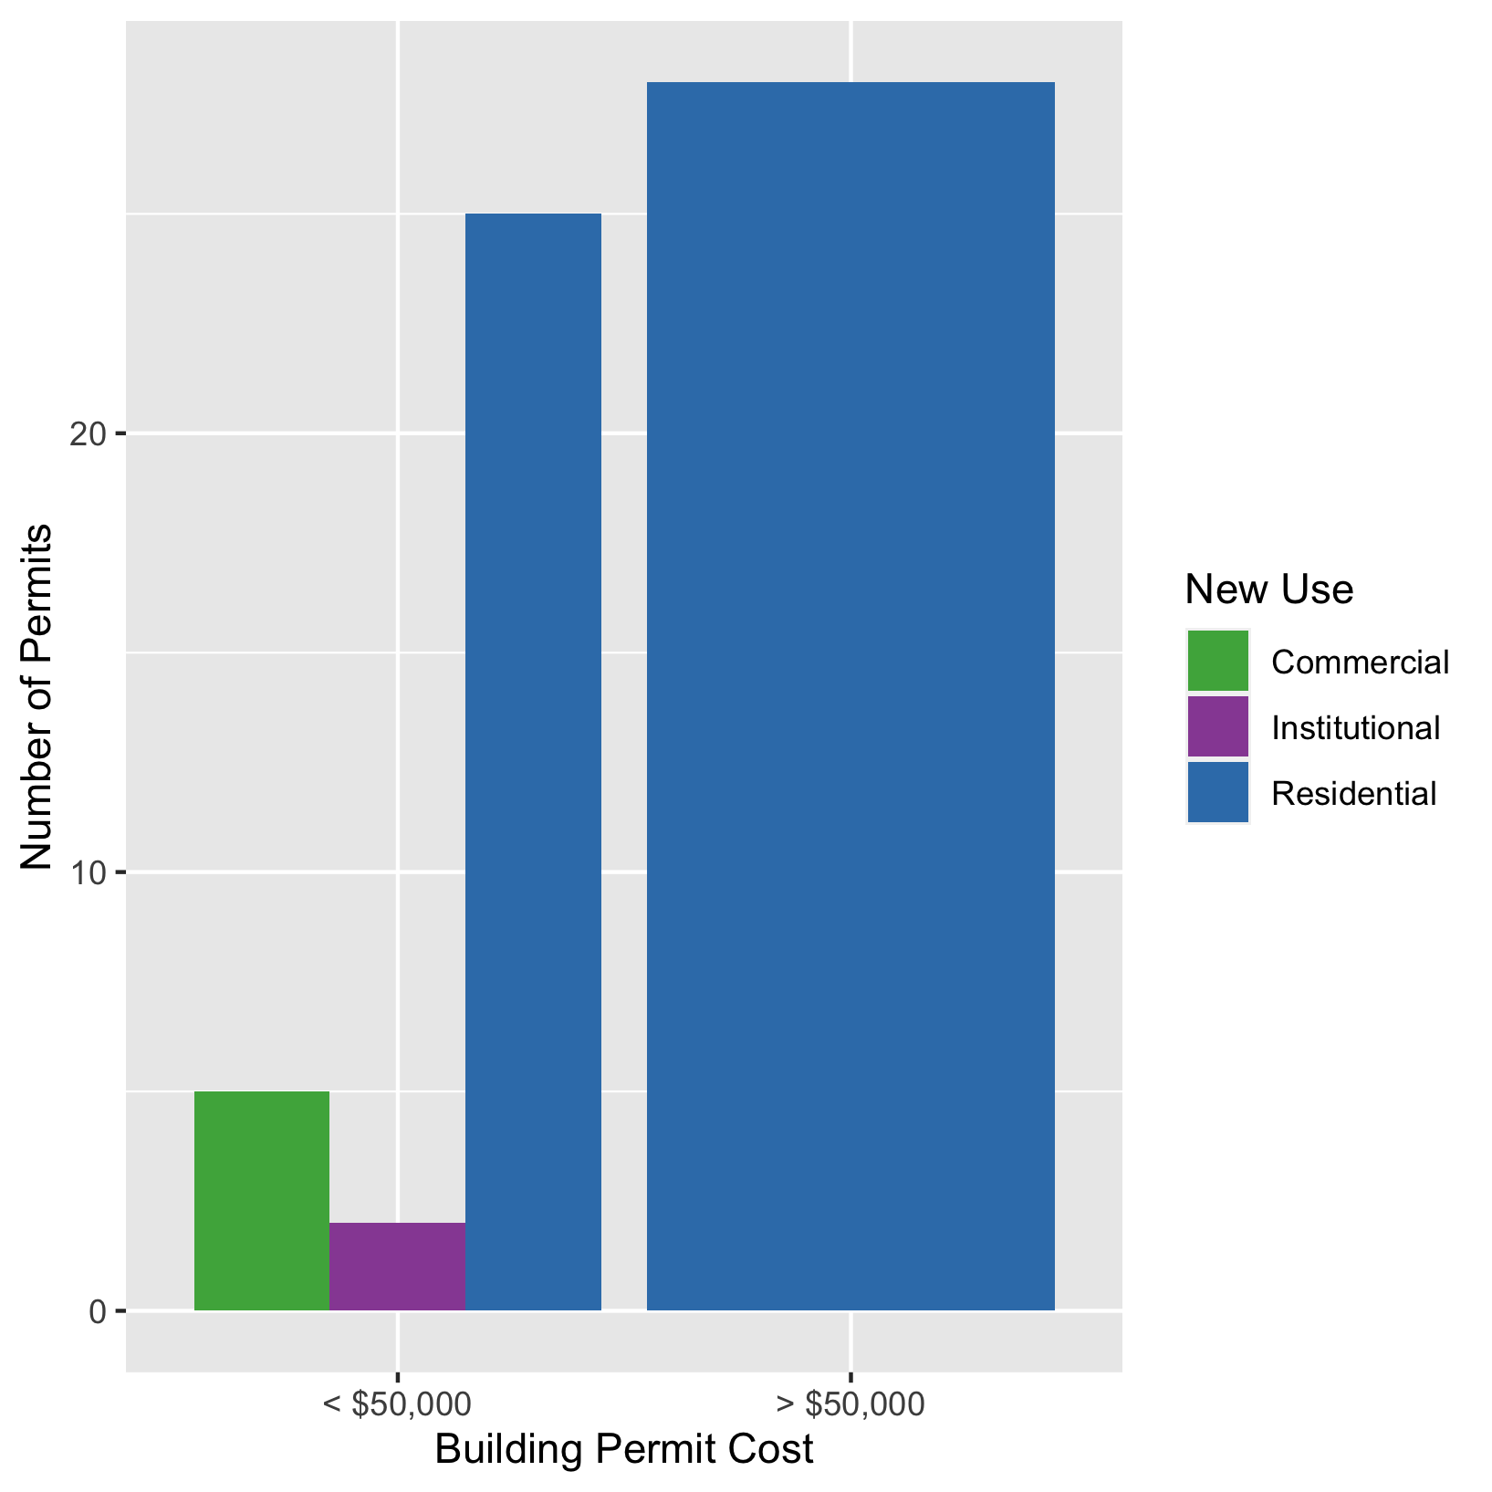
DeBaliviere Place
New Use | Average Cost | # of Permits
Commercial | $10,756 | 5
Institutional | $4,200 | 2
Residential | $651,840 | 53

Slide 16
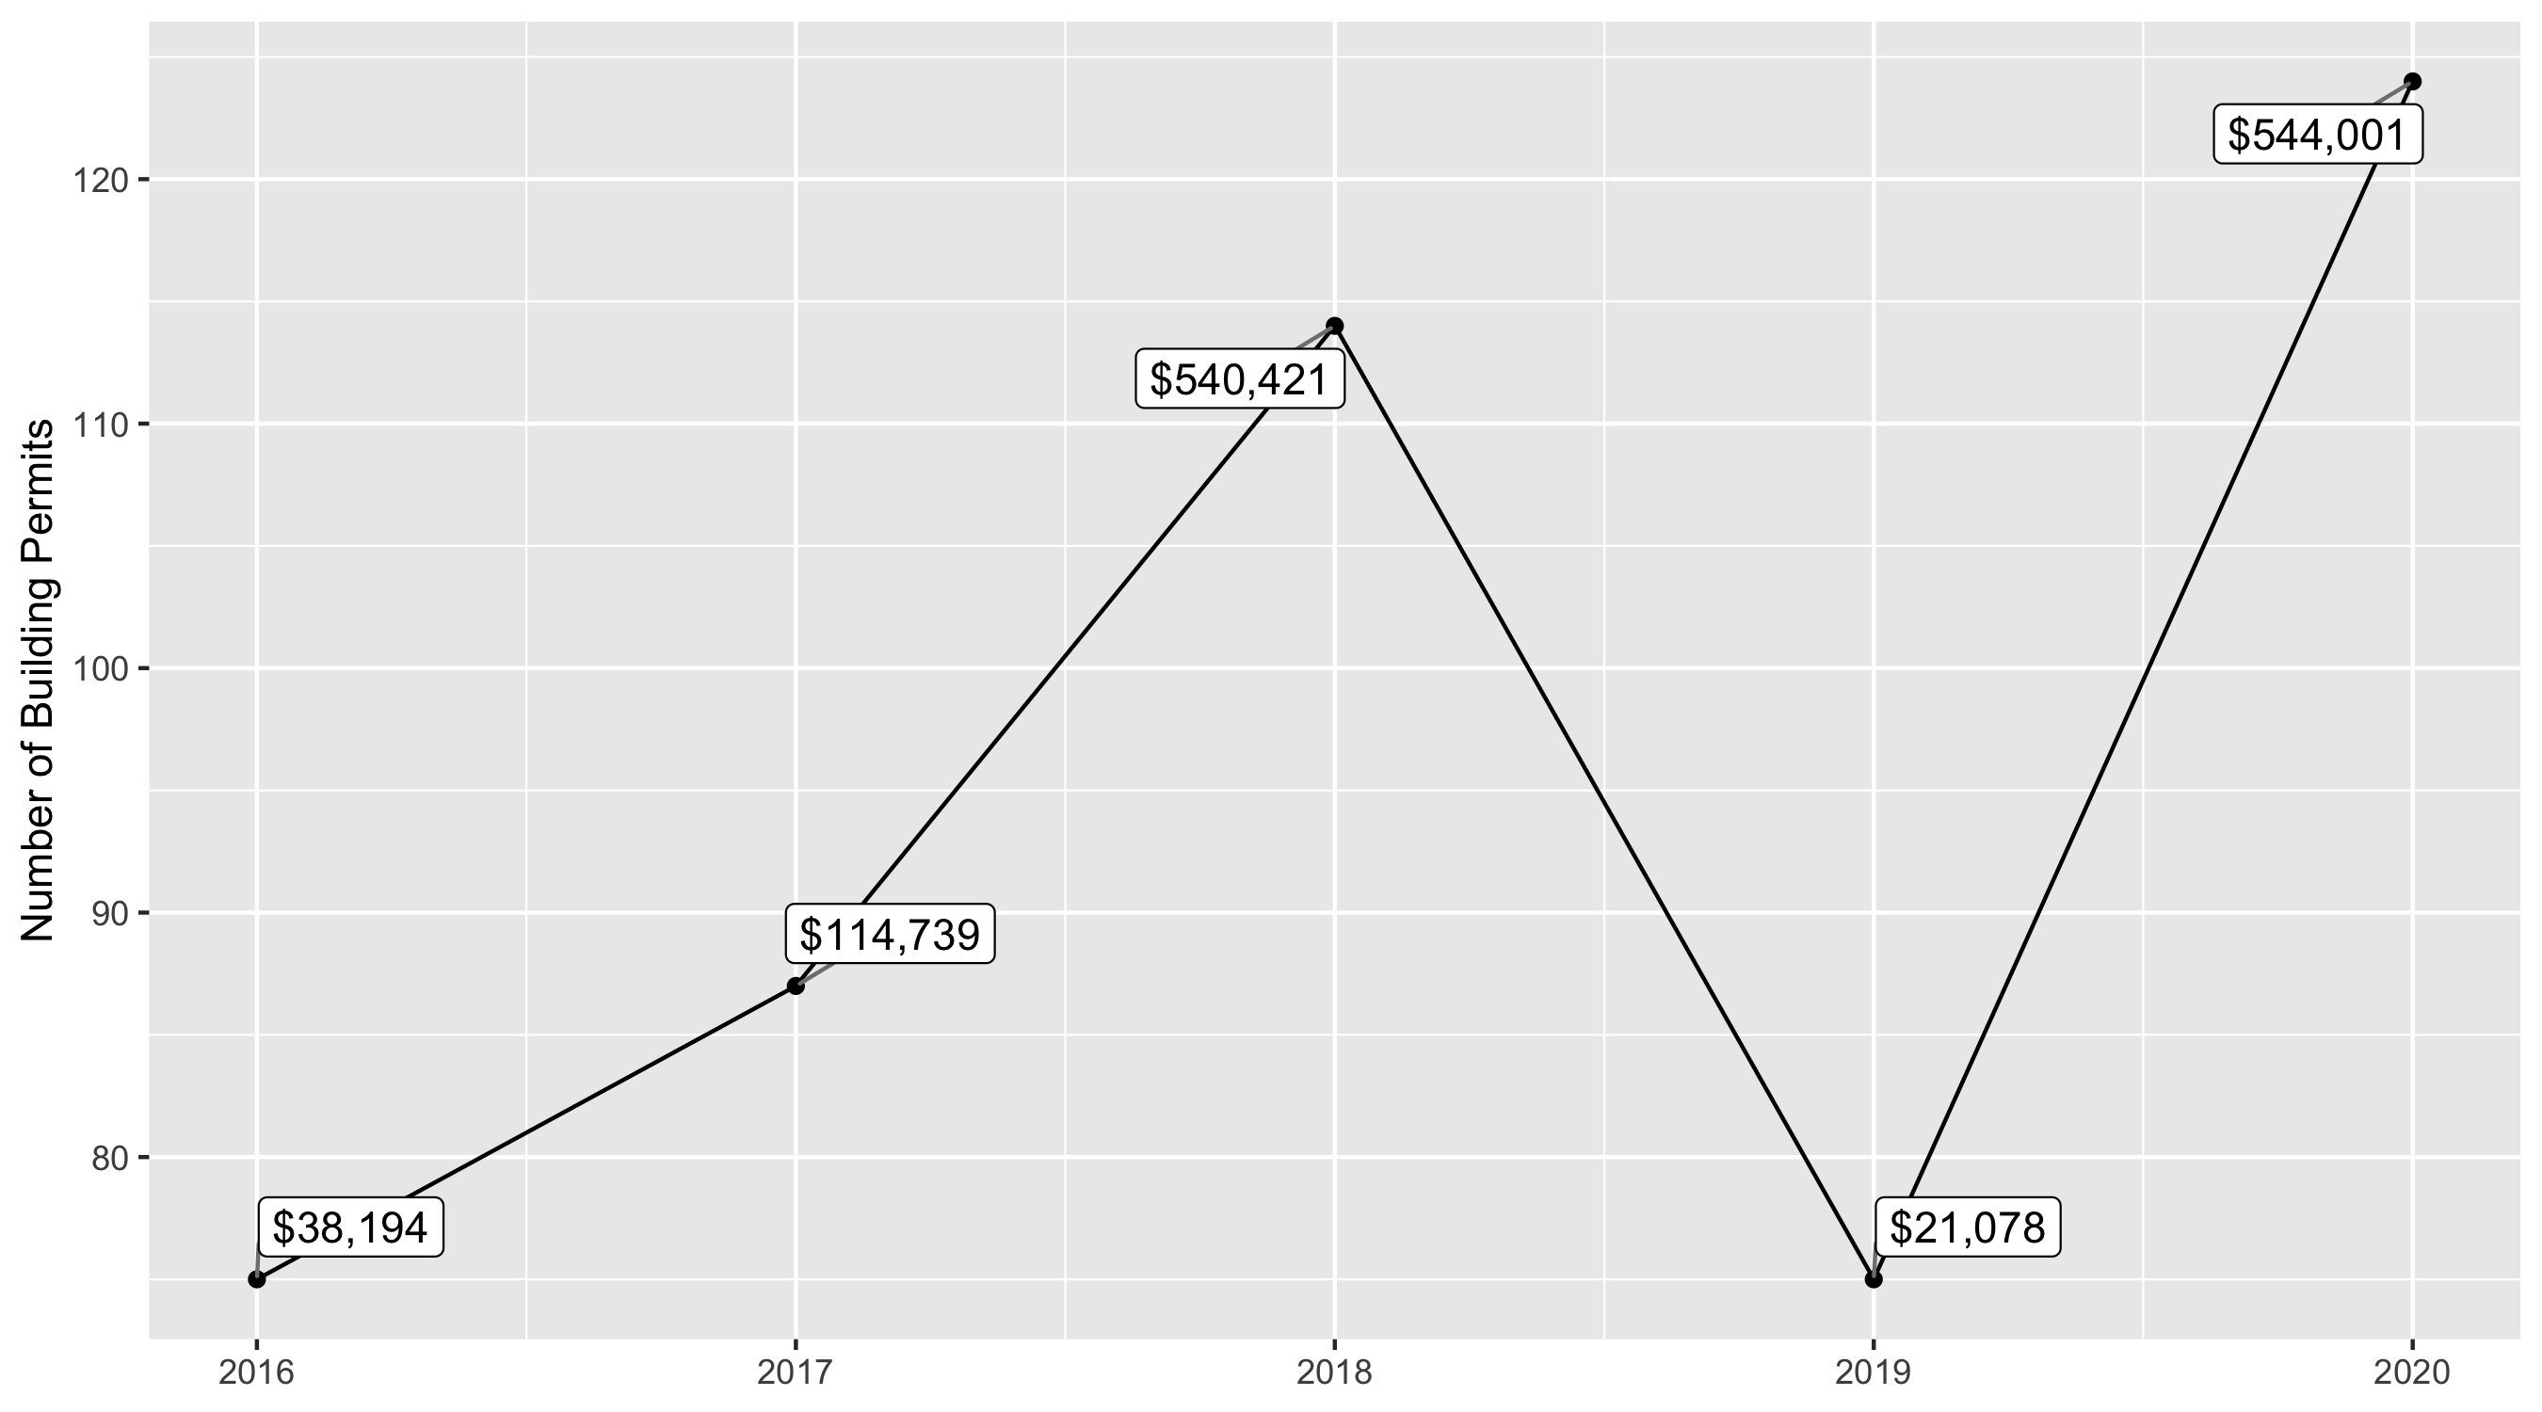
Skinker DeBaliviere 5 Year Analysis

Slide 17
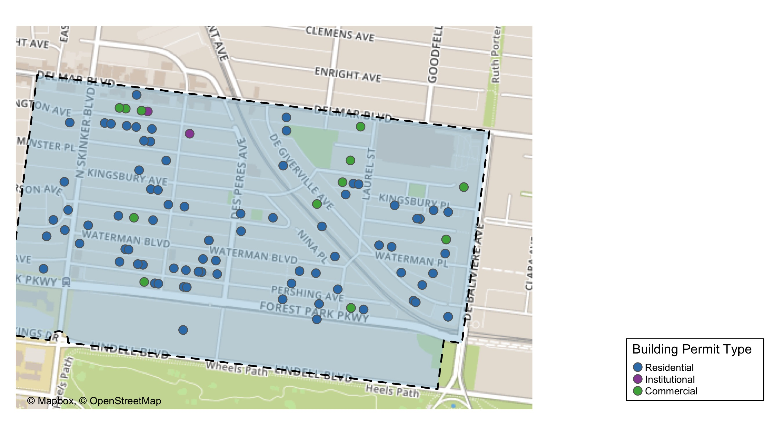
Skinker DeBaliviere

Slide 18
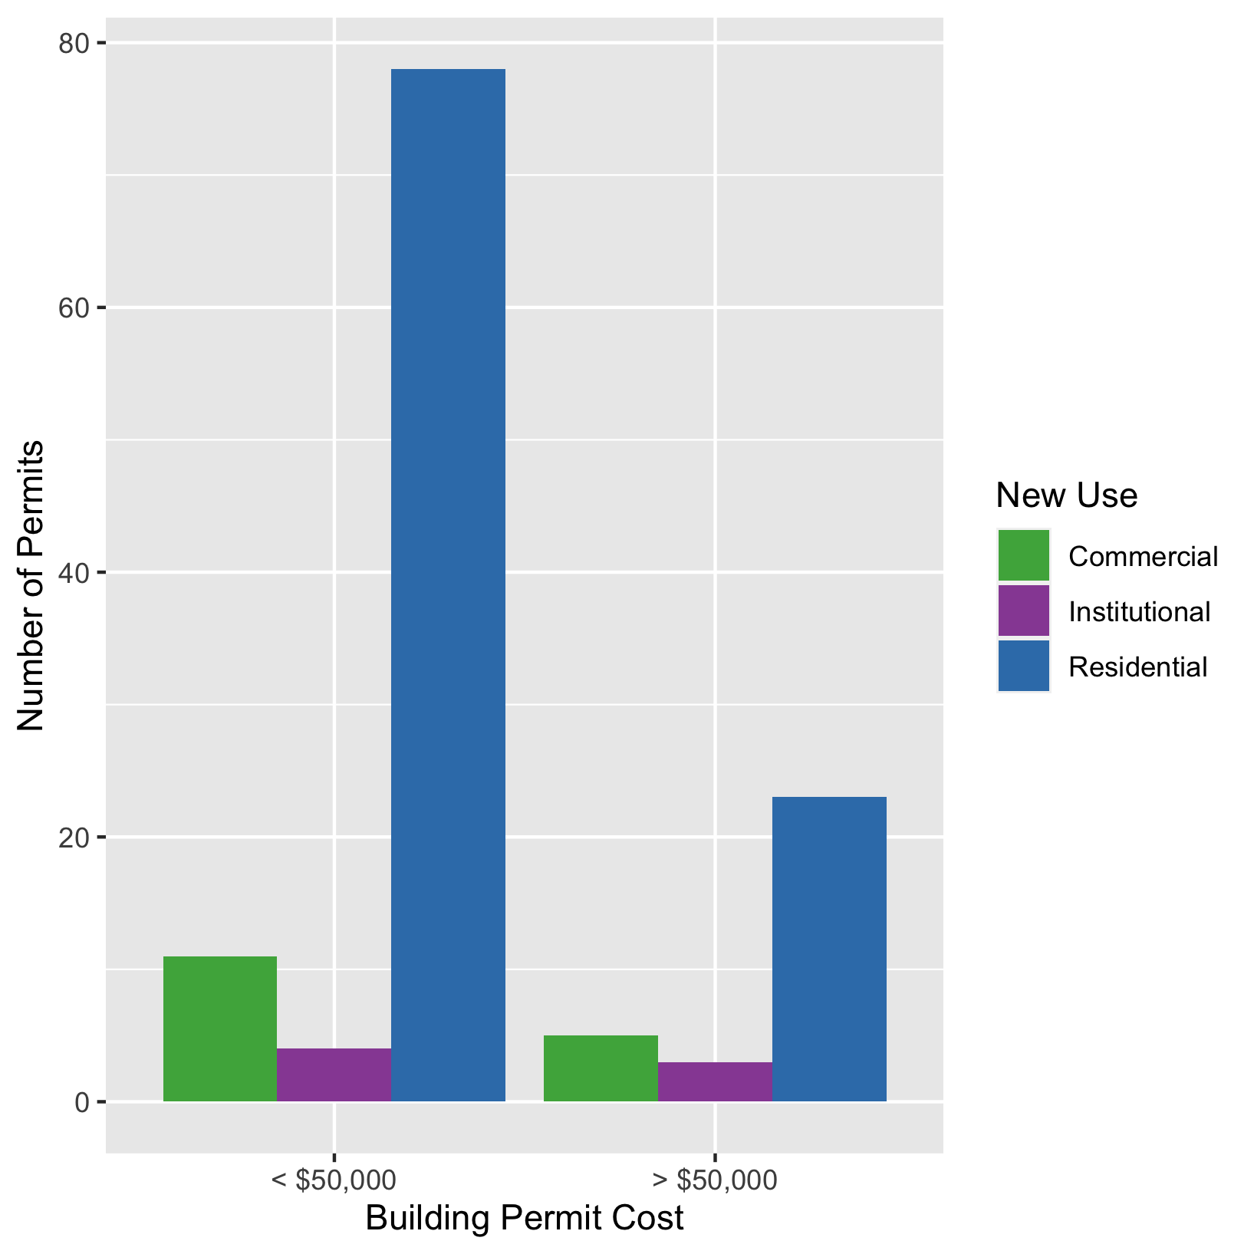
Skinker DeBaliviere
New Use | Average Cost | # of Permits
Commercial | $3,571,005 | 16
Institutional | $534,800 | 7
Residential | $65,113 | 101

Slide 19
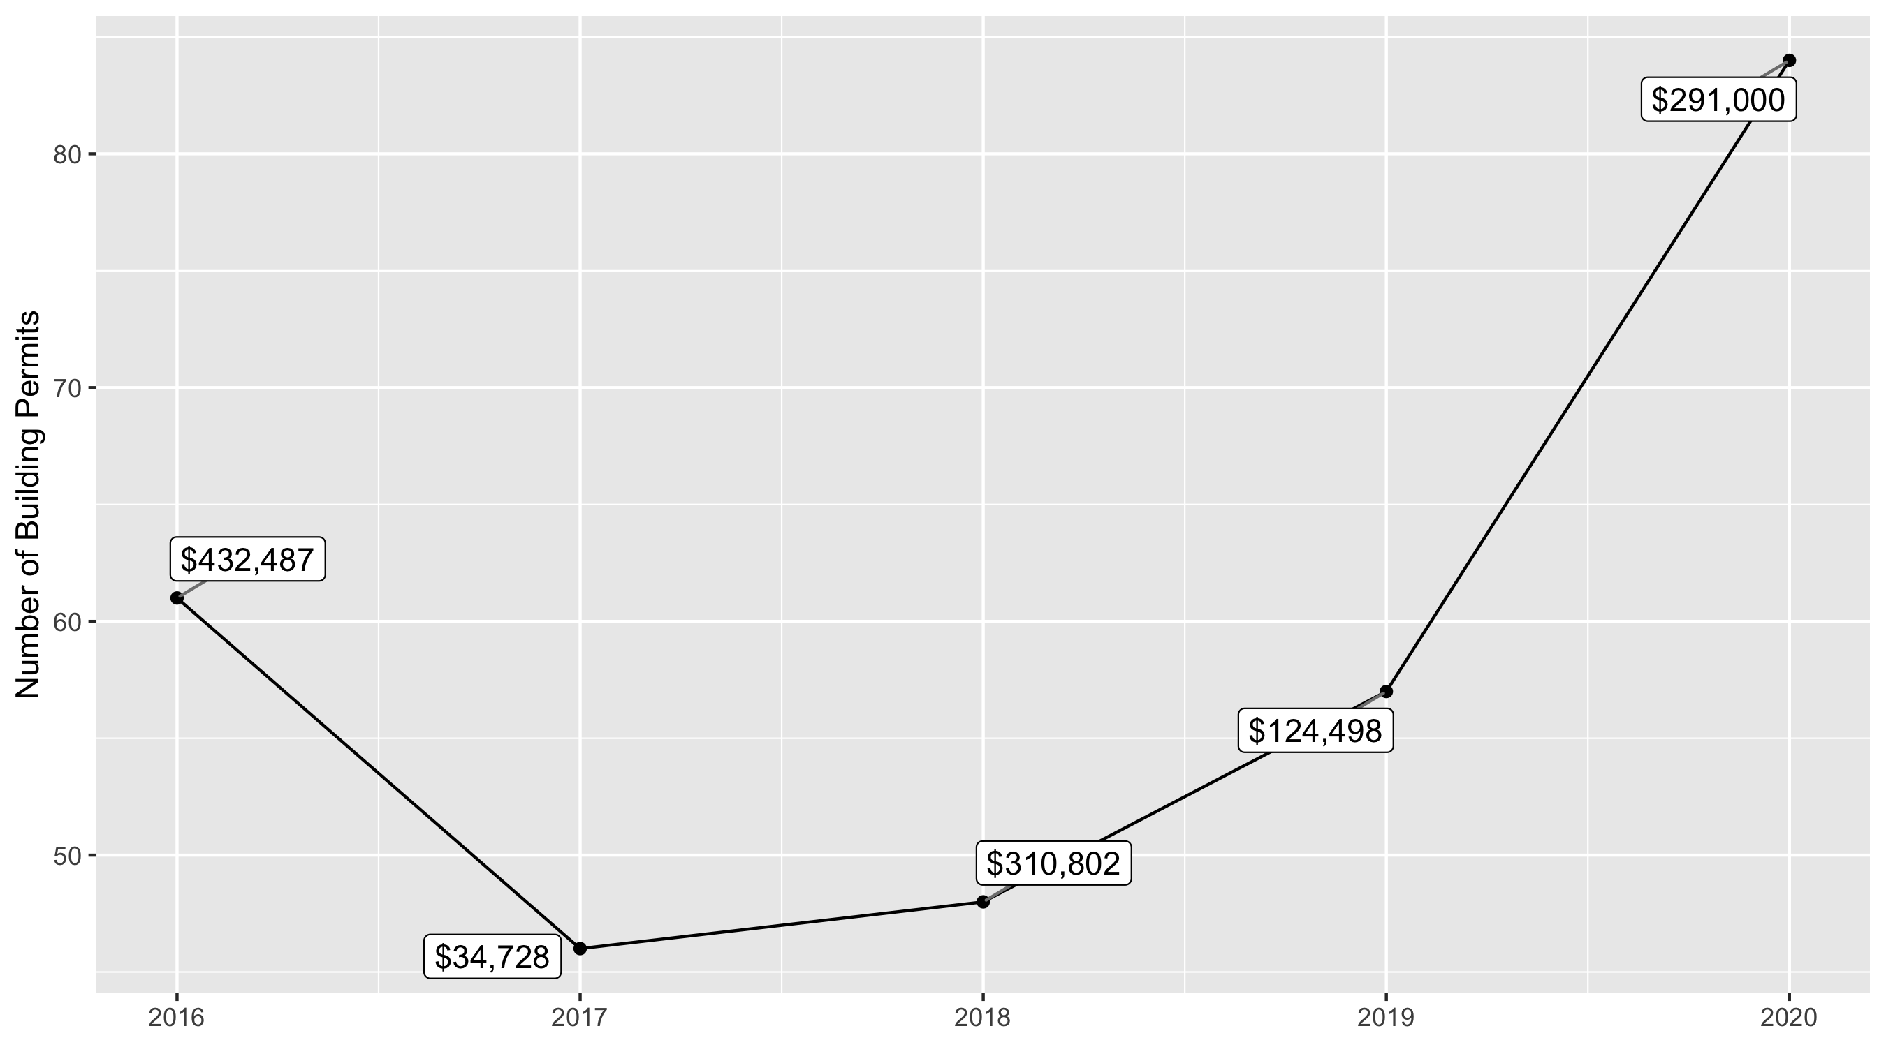
West End 5 Year Analysis

Slide 20
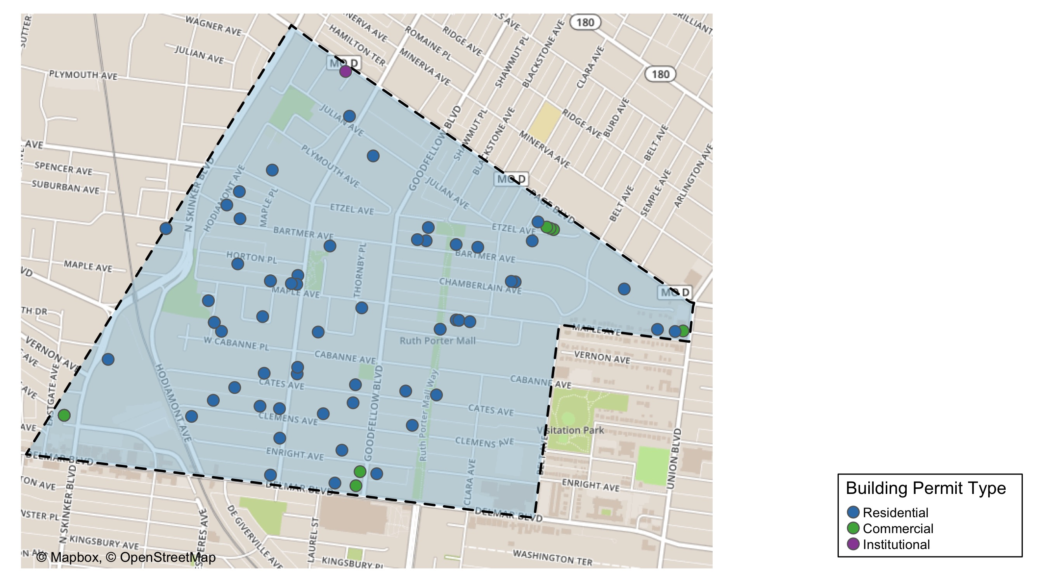
West End

Slide 21
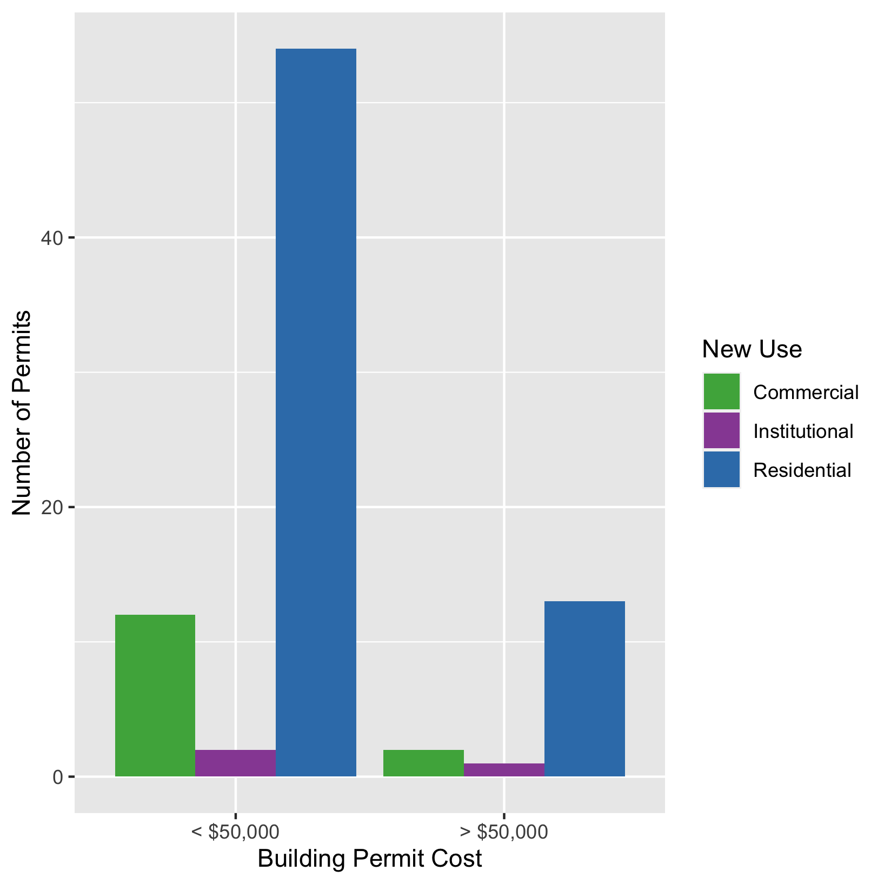
West End
New Use | Average Cost | # of Permits
Commercial | $48,391 | 14
Institutional | $3,182,012 | 3
Residential | $212,246 | 67

Slide 22
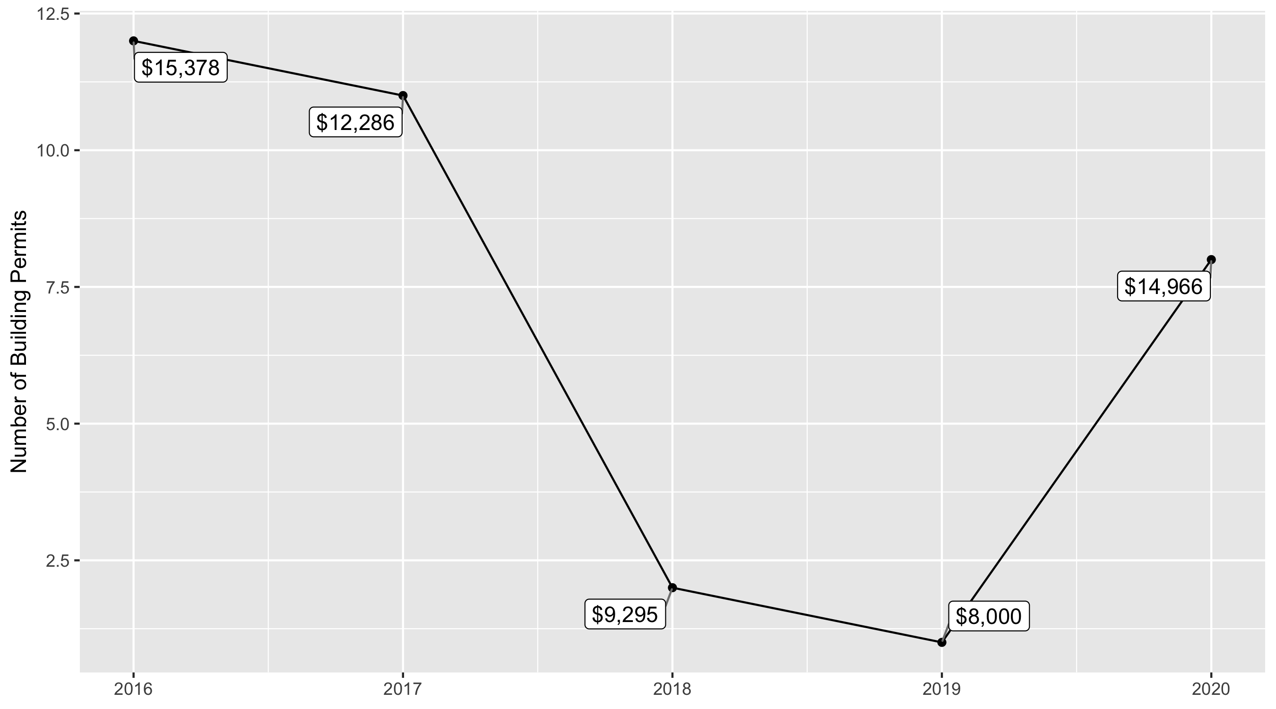
Visitation Park 5 Year Analysis

Slide 23
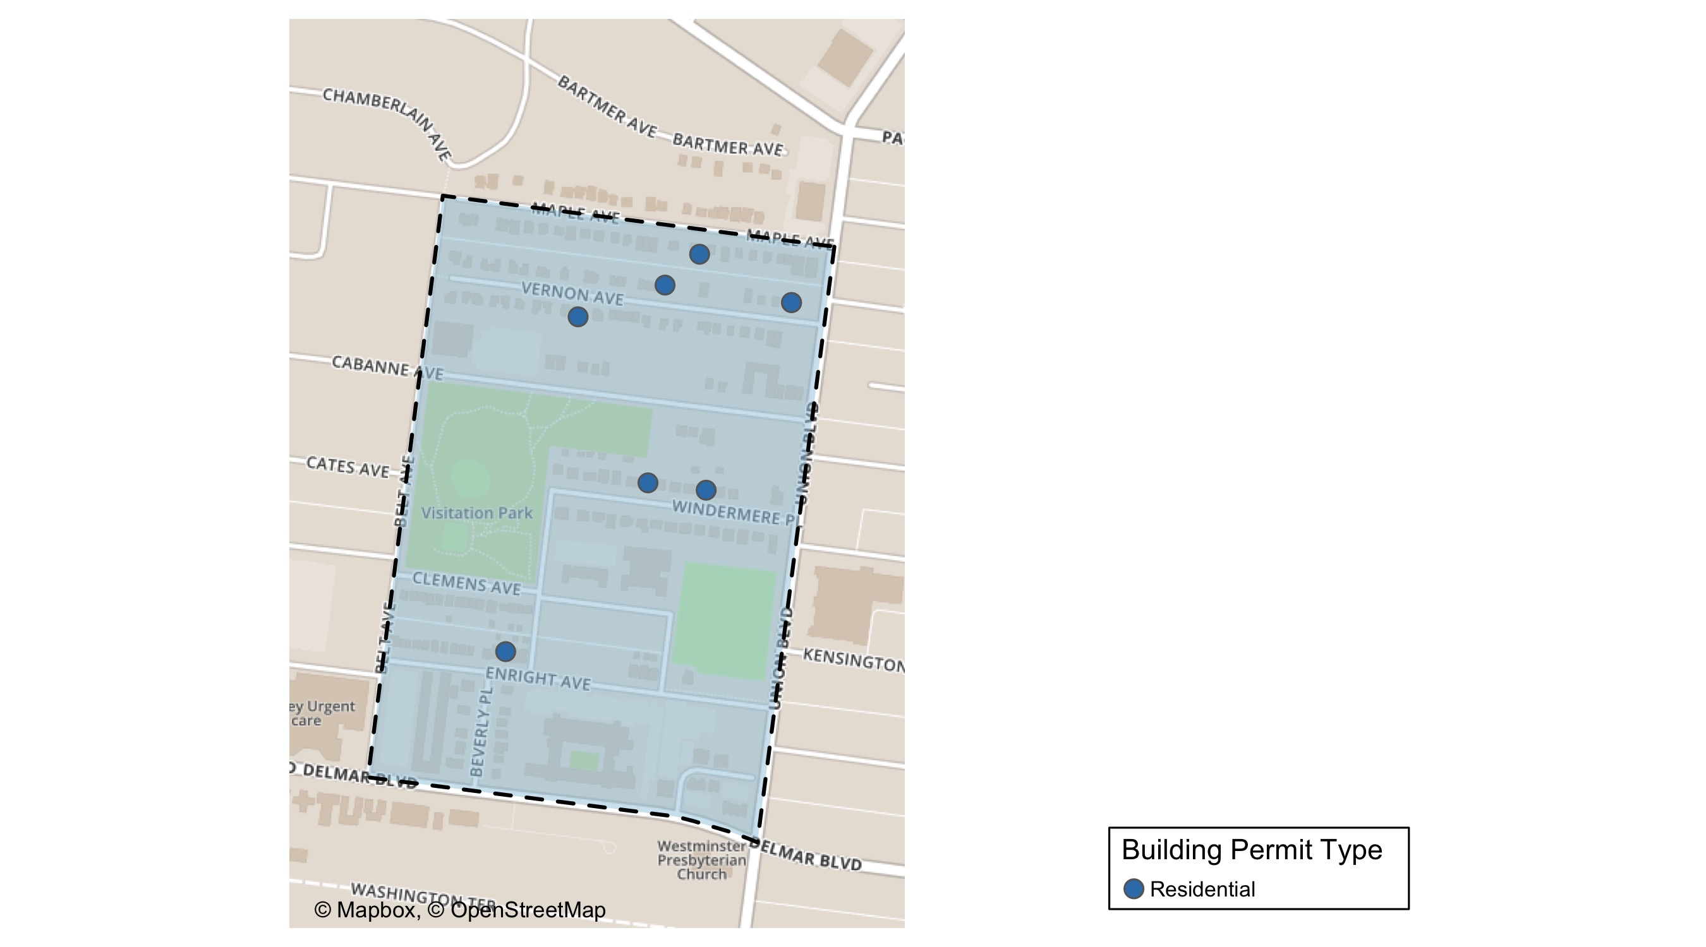
Visitation Park

Slide 24
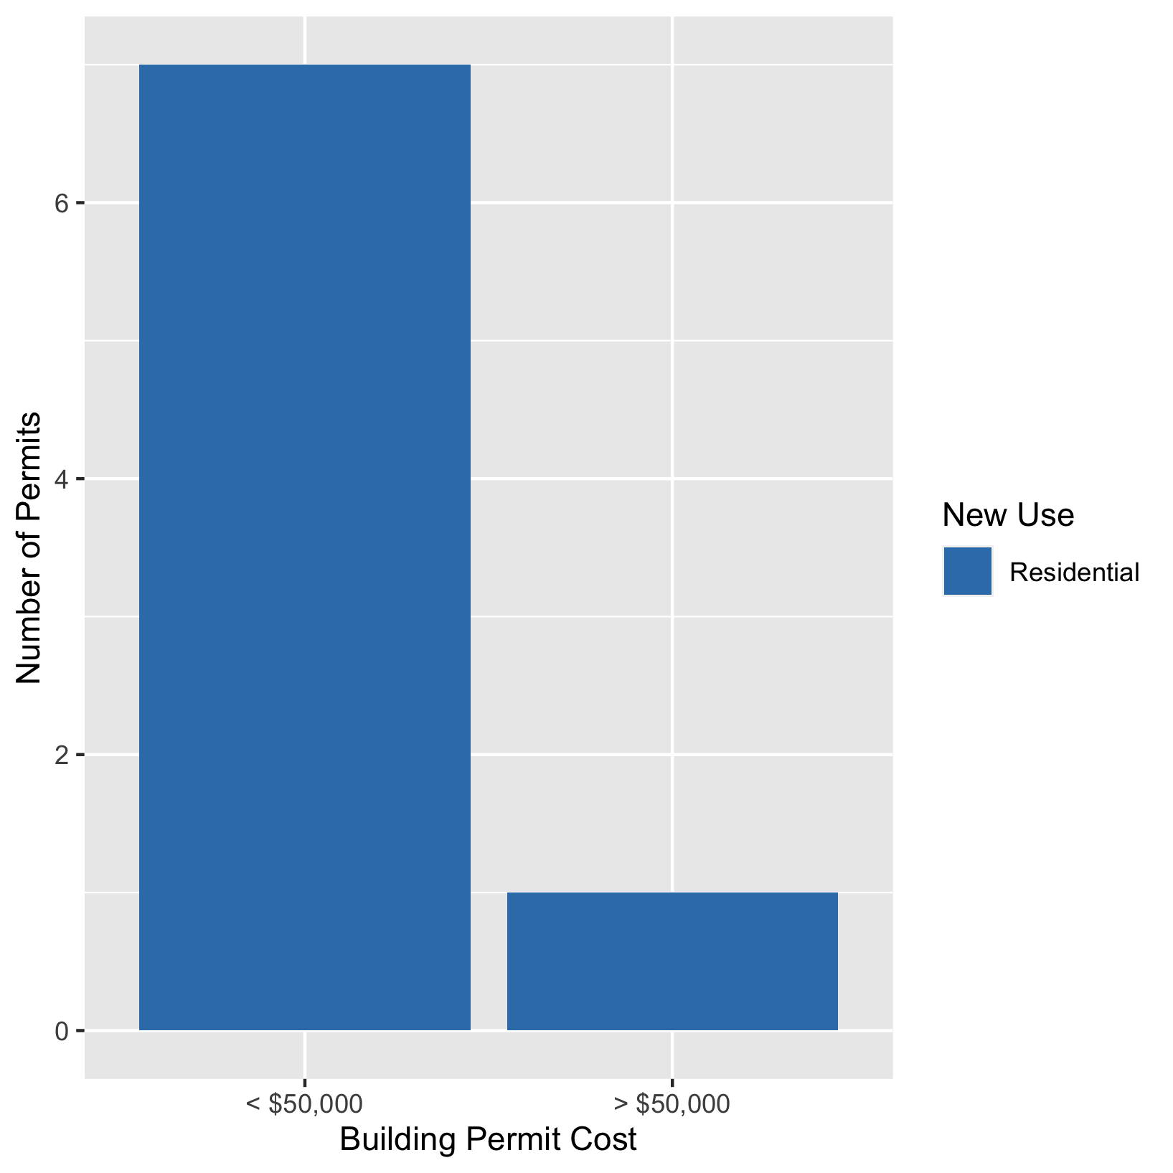
Visitation Park
New Use | Average Cost | # of Permits
Residential | $14,966 | 8

Slide 25
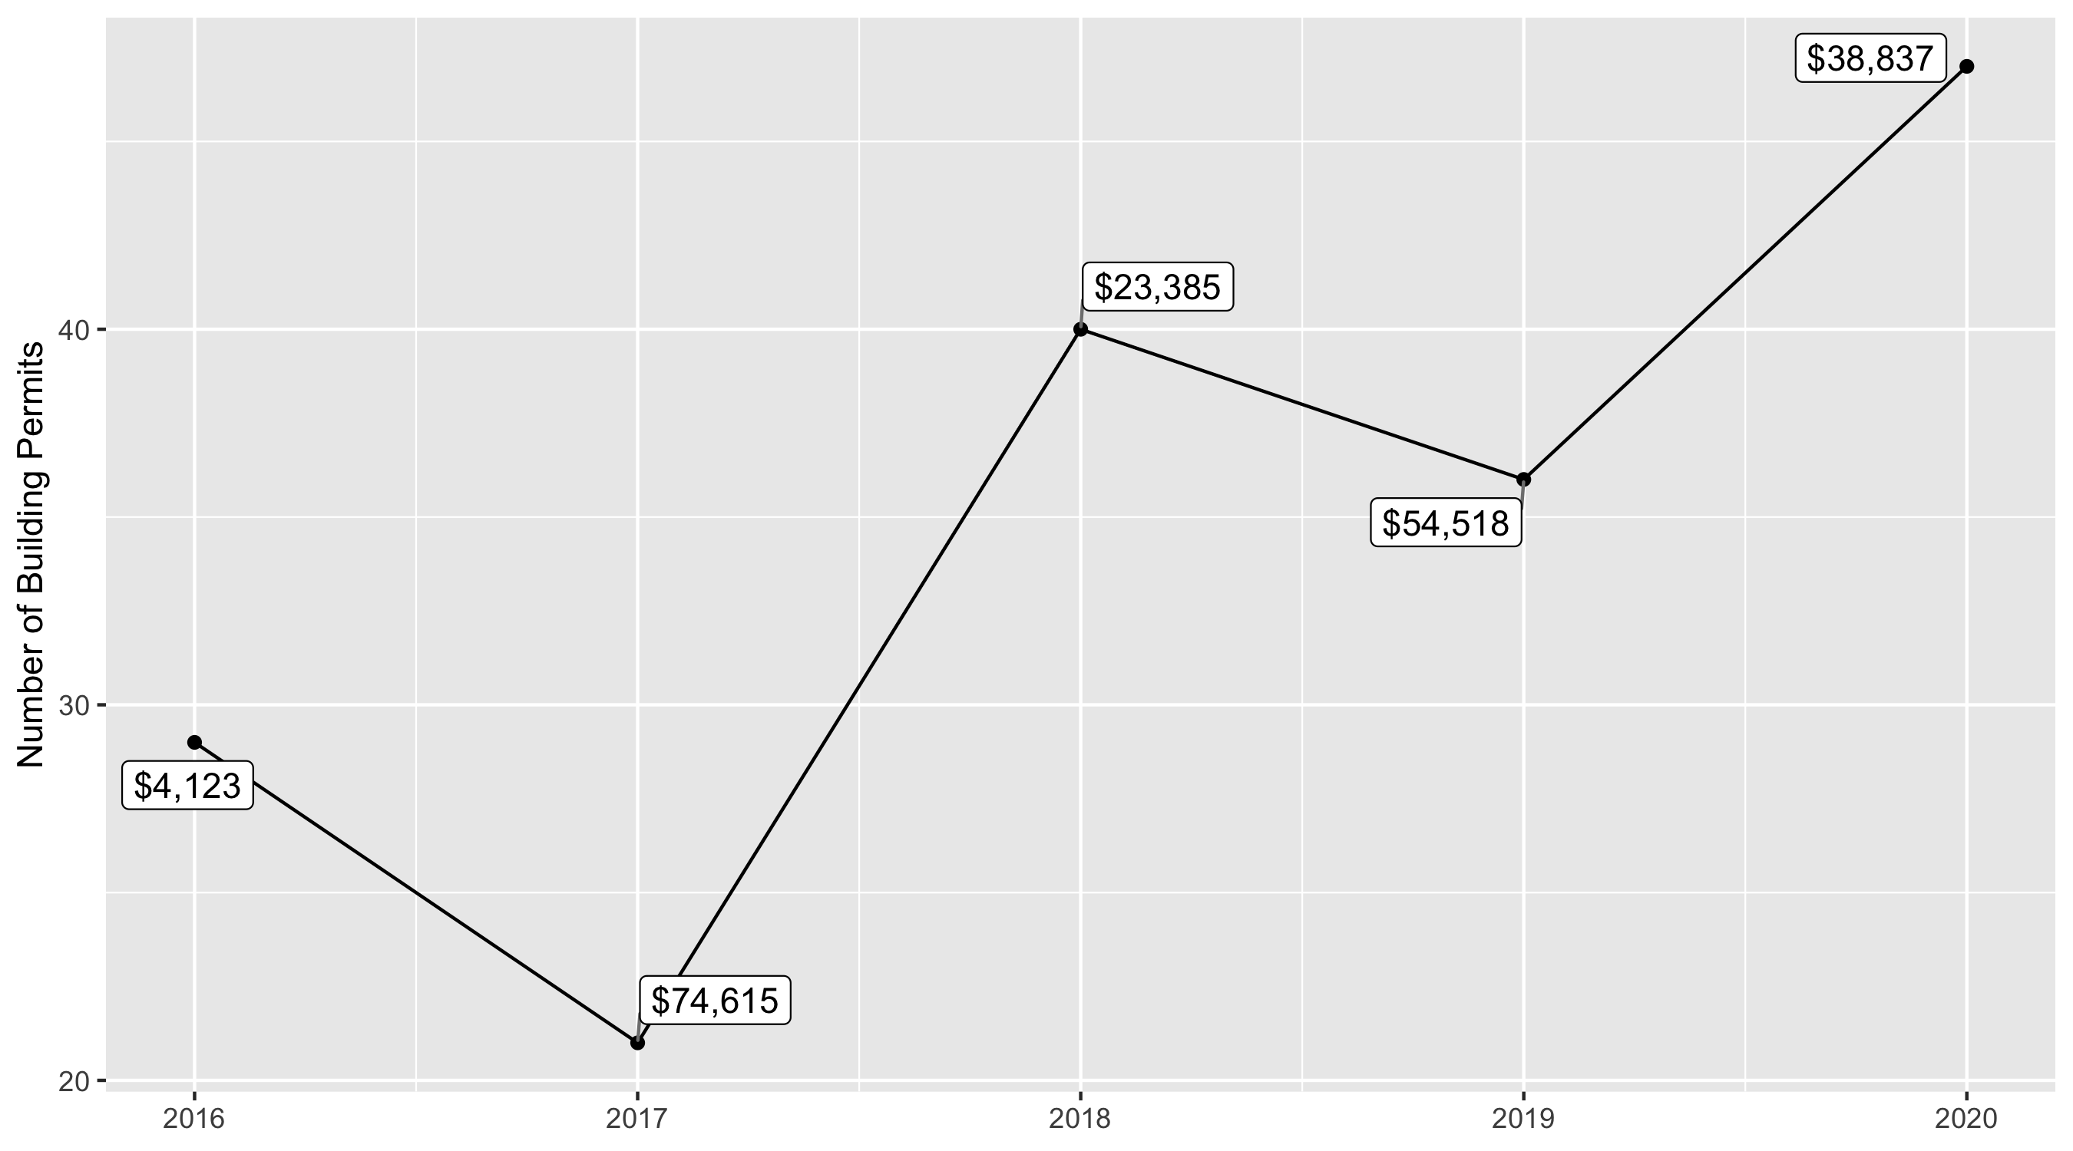
Academy 5 Year Analysis

Slide 26
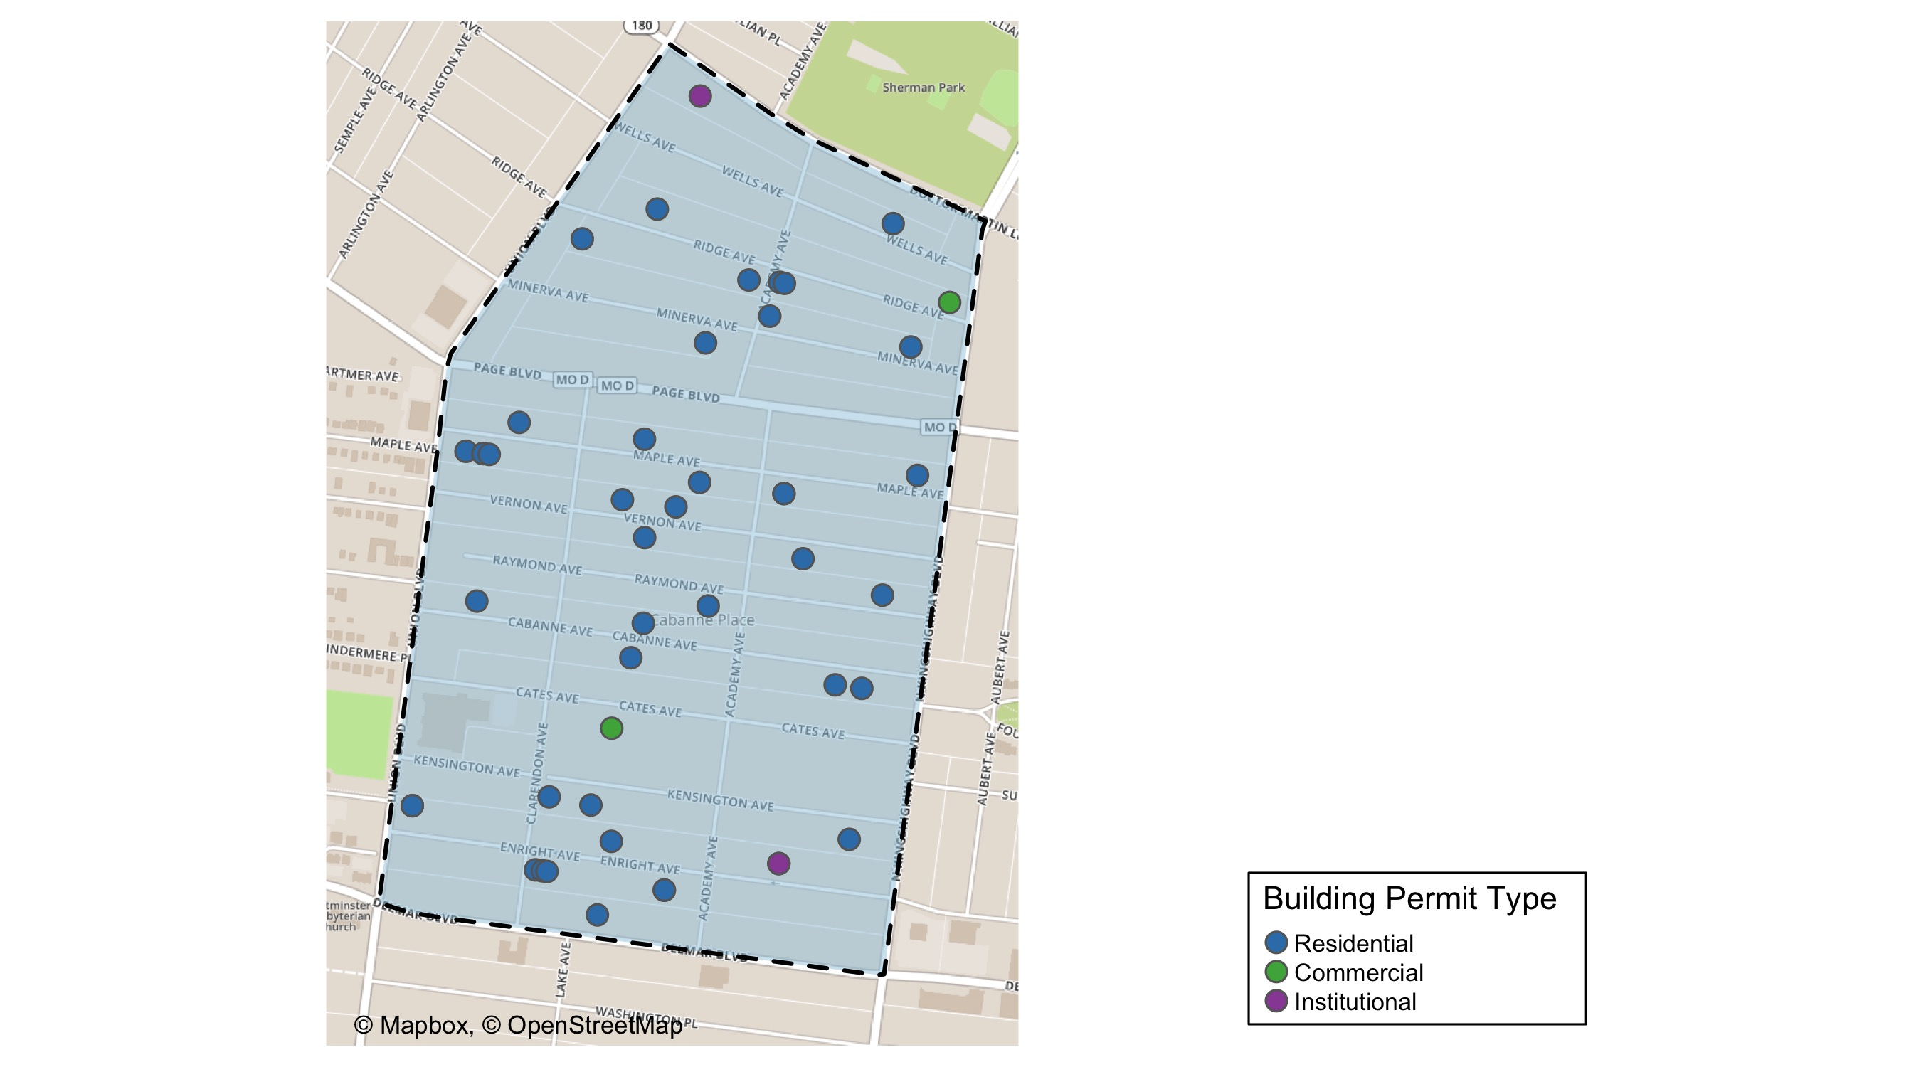
Academy

Slide 27
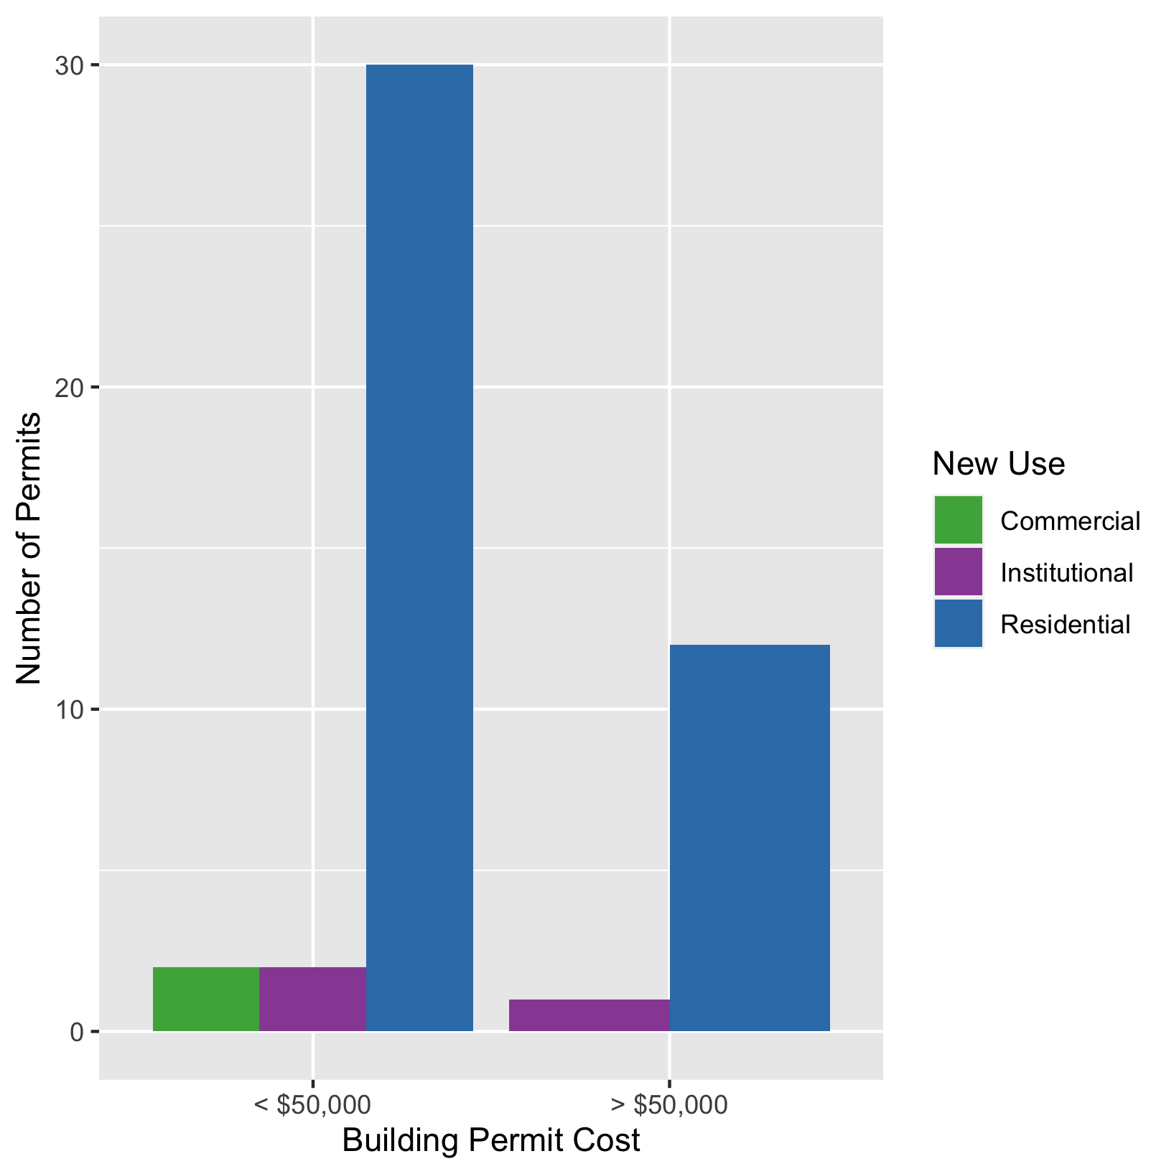
Academy
New Use | Average Cost | # of Permits
Commercial | $12,500 | 2
Institutional | $36,833 | 3
Residential | $40,234 | 42

Slide 28
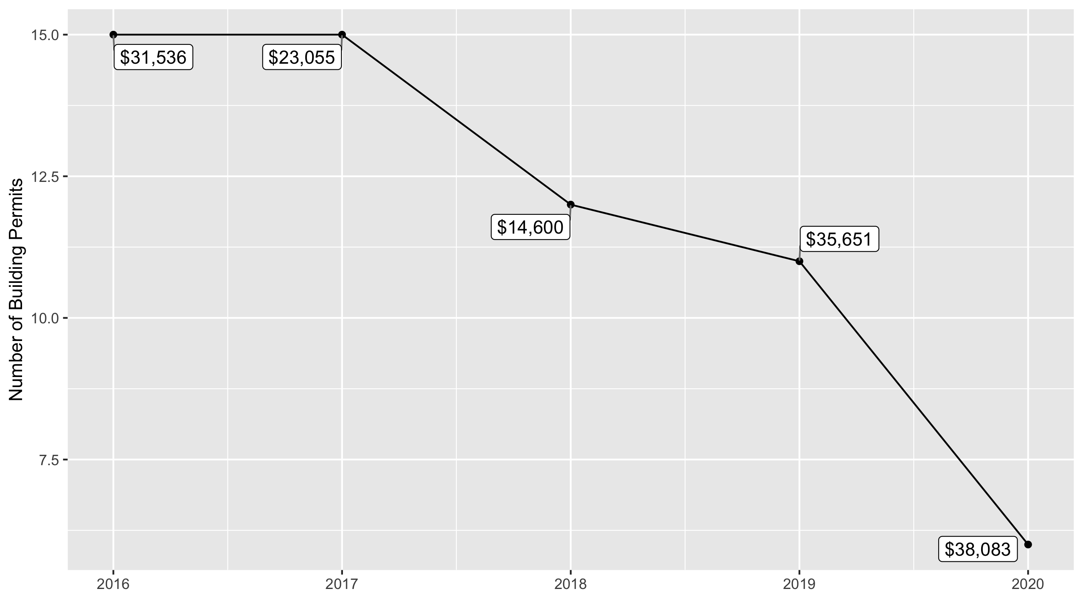
Fountain Park 5 Year Analysis

Slide 29
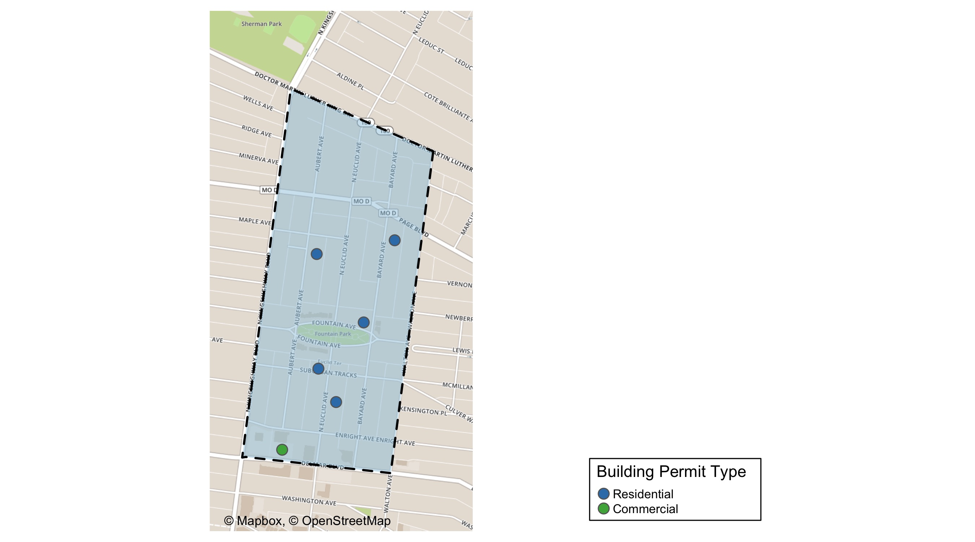
Fountain Park

Slide 30
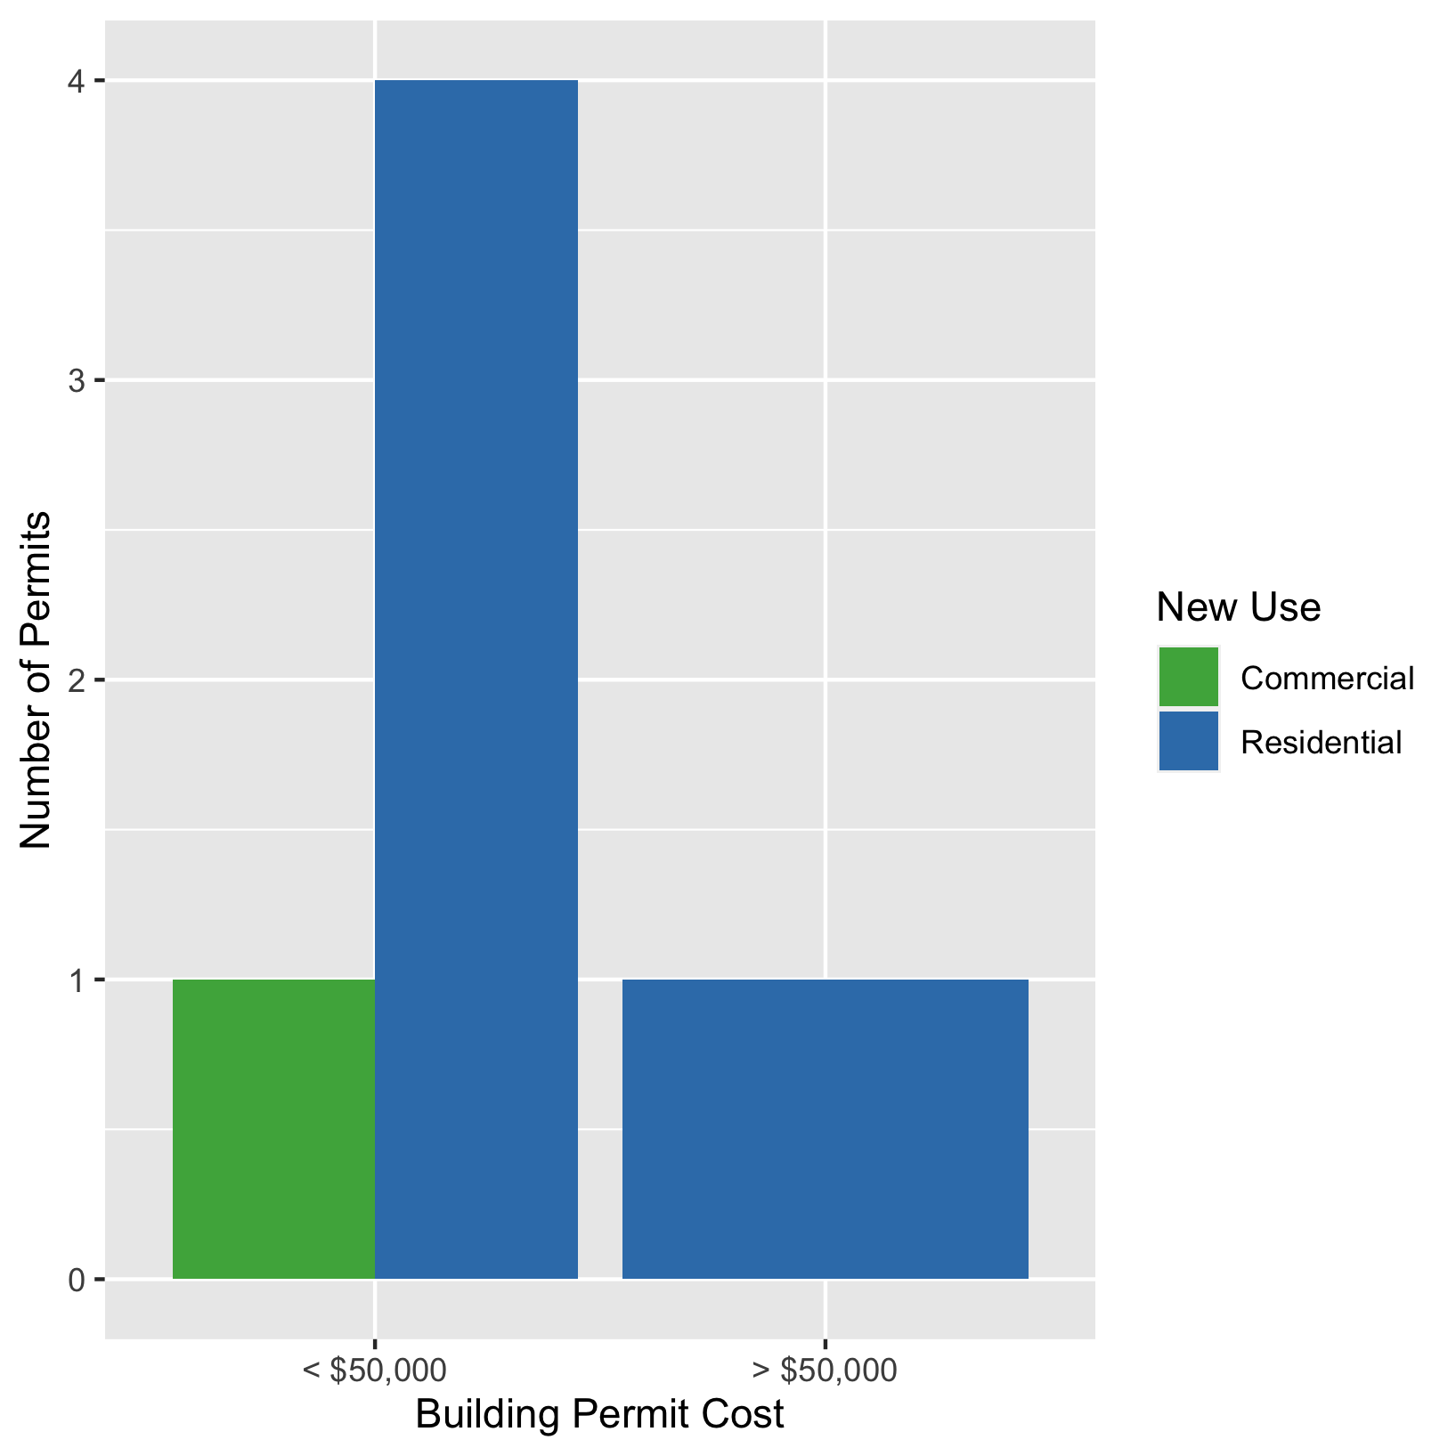
Fountain Park
New Use | Average Cost | # of Permits
Commercial | $30,000 | 1
Residential | $39,700 | 5

Slide 31
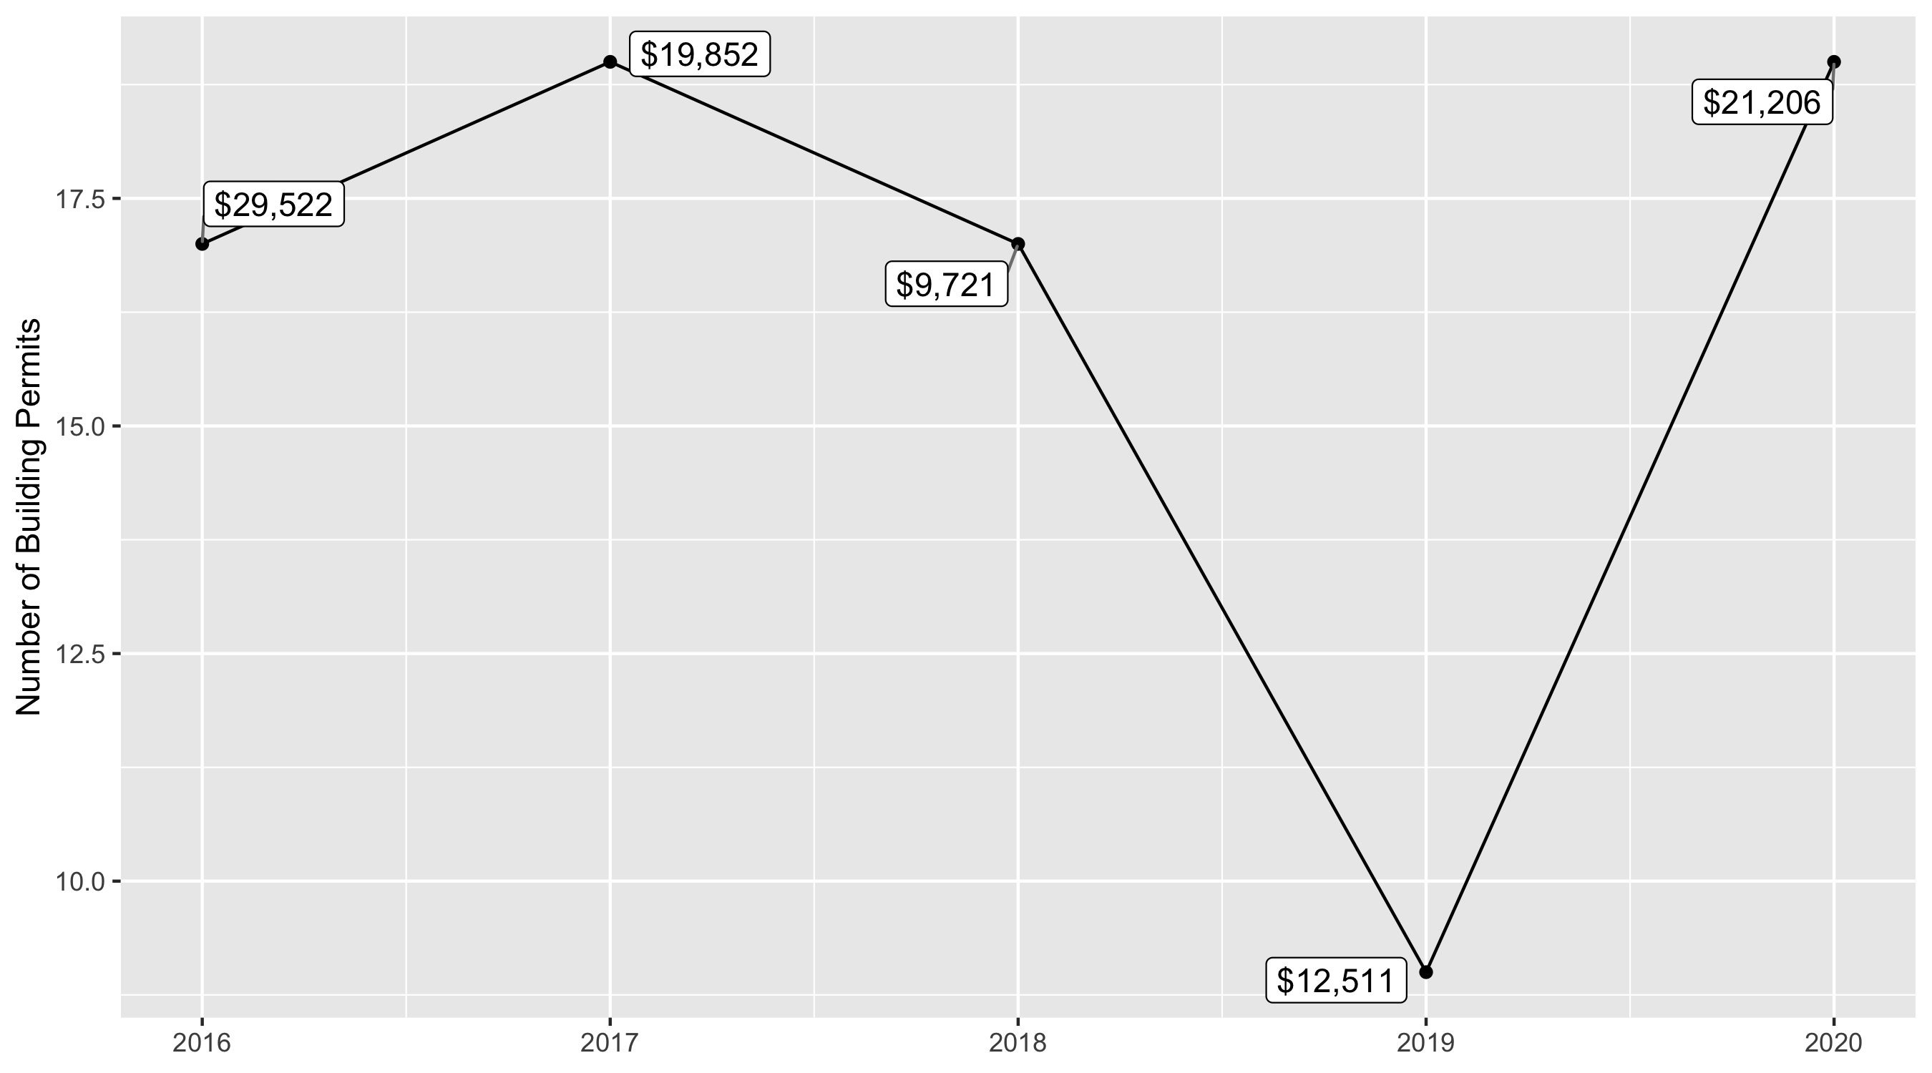
Lewis Place 5 Year Analysis

Slide 32
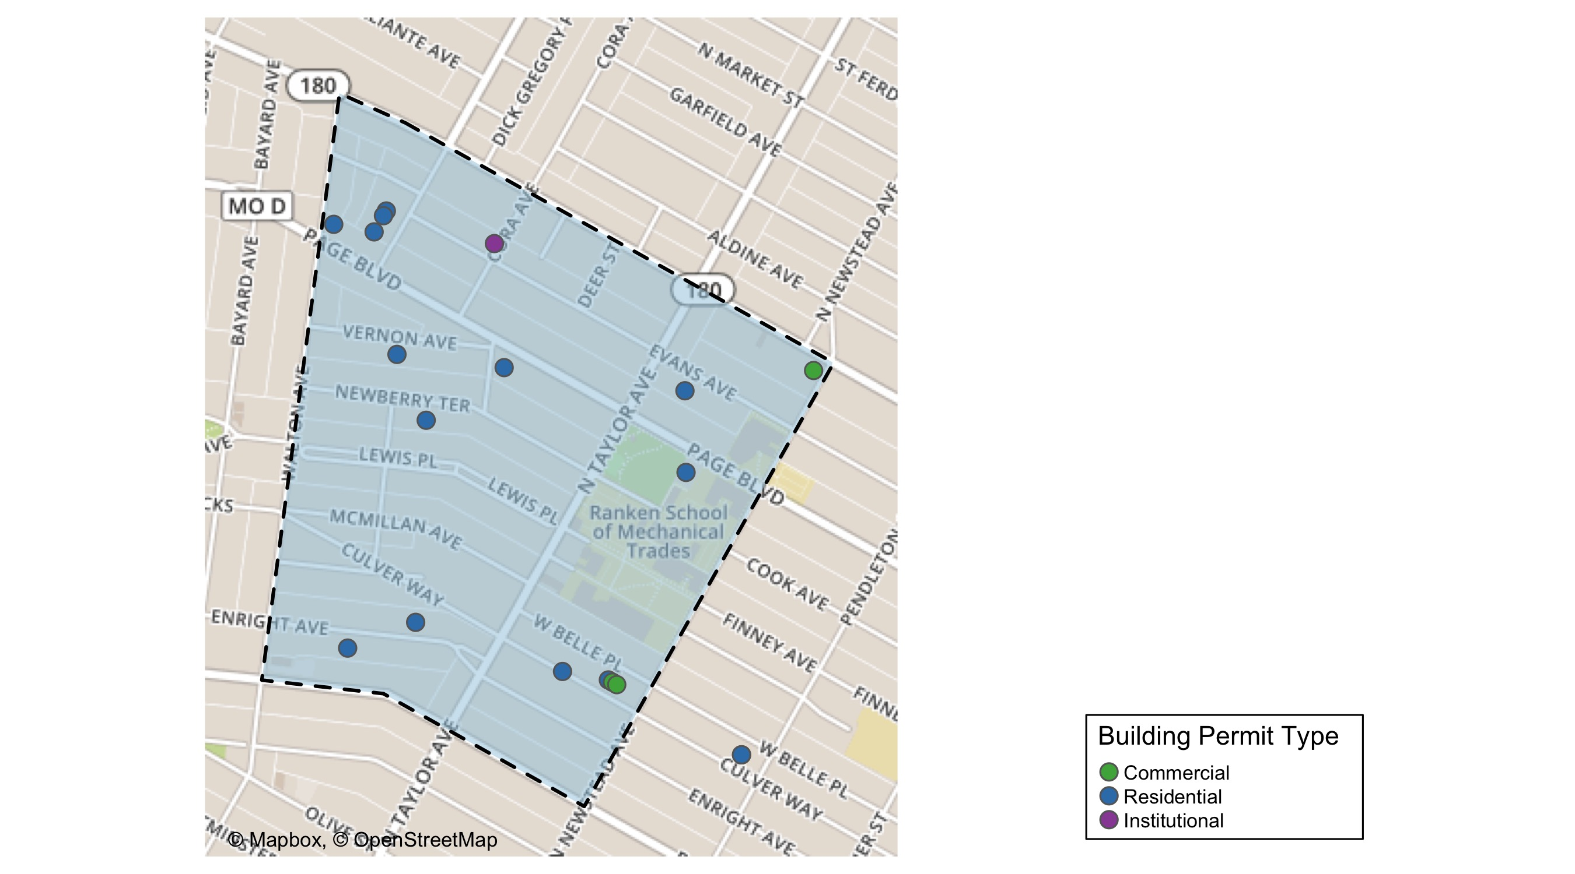
Lewis Place

Slide 33
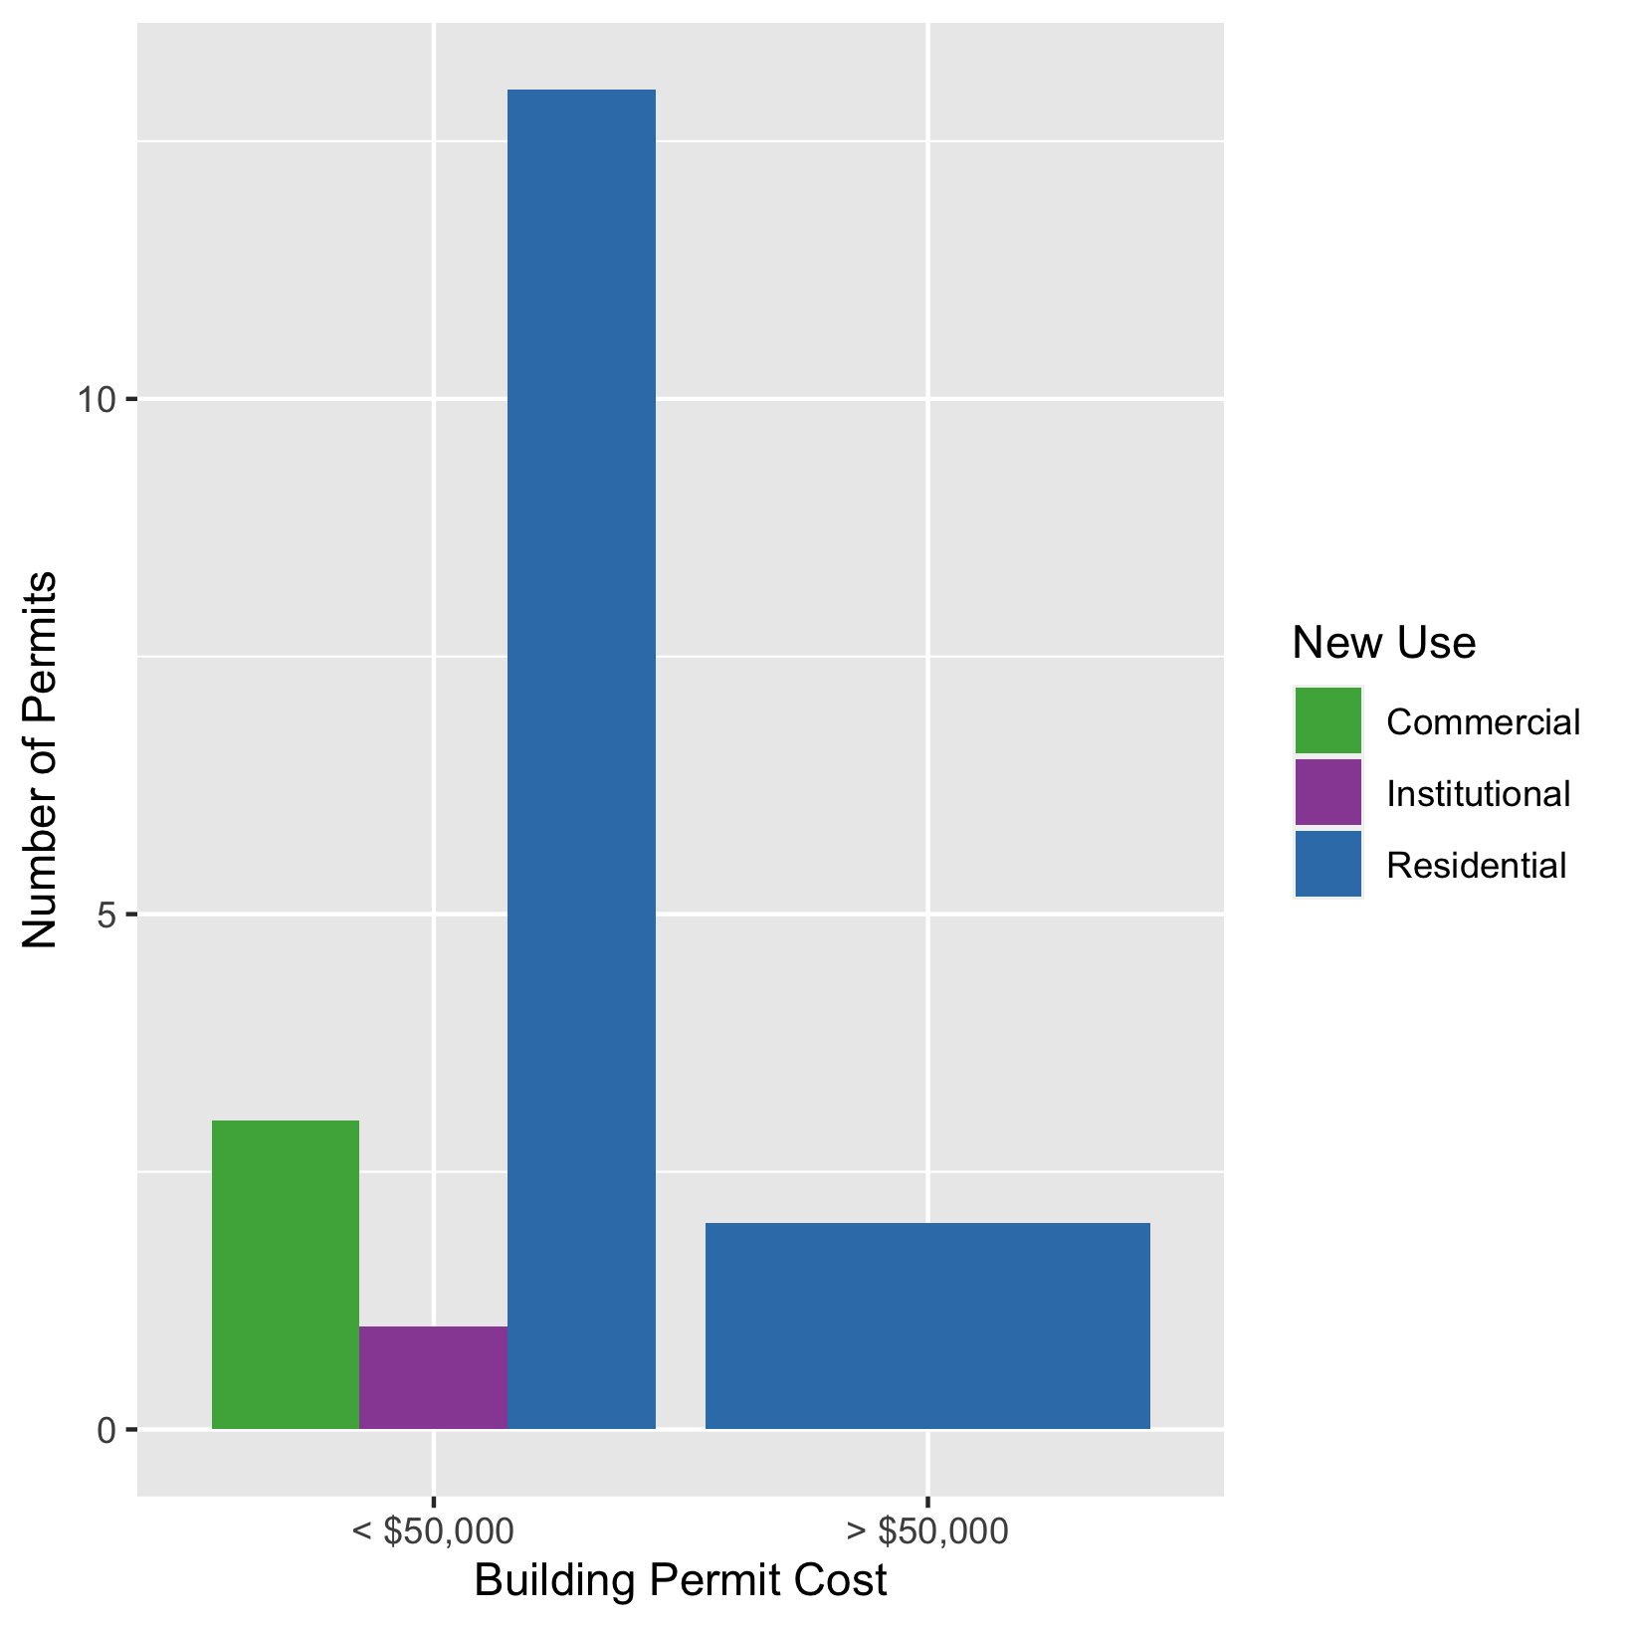
Lewis Place
New Use | Average Cost | # of Permits
Commercial | $3,400 | 3
Institutional | $10,000 | 1
Residential | $25,515 | 15

Slide 34
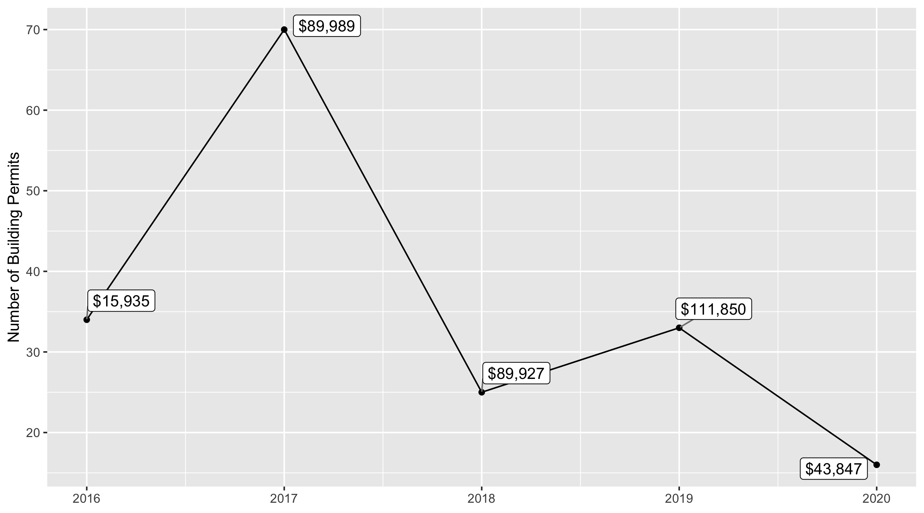
Vandeventer 5 Year Analysis

Slide 35
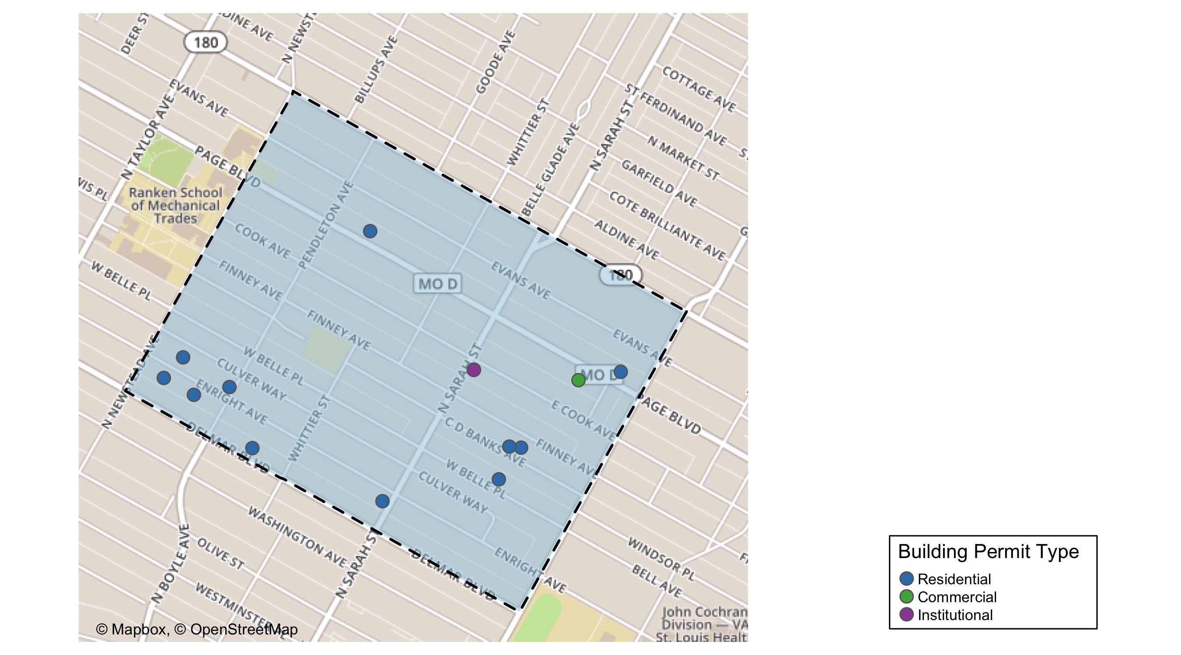
Vandeventer

Slide 36
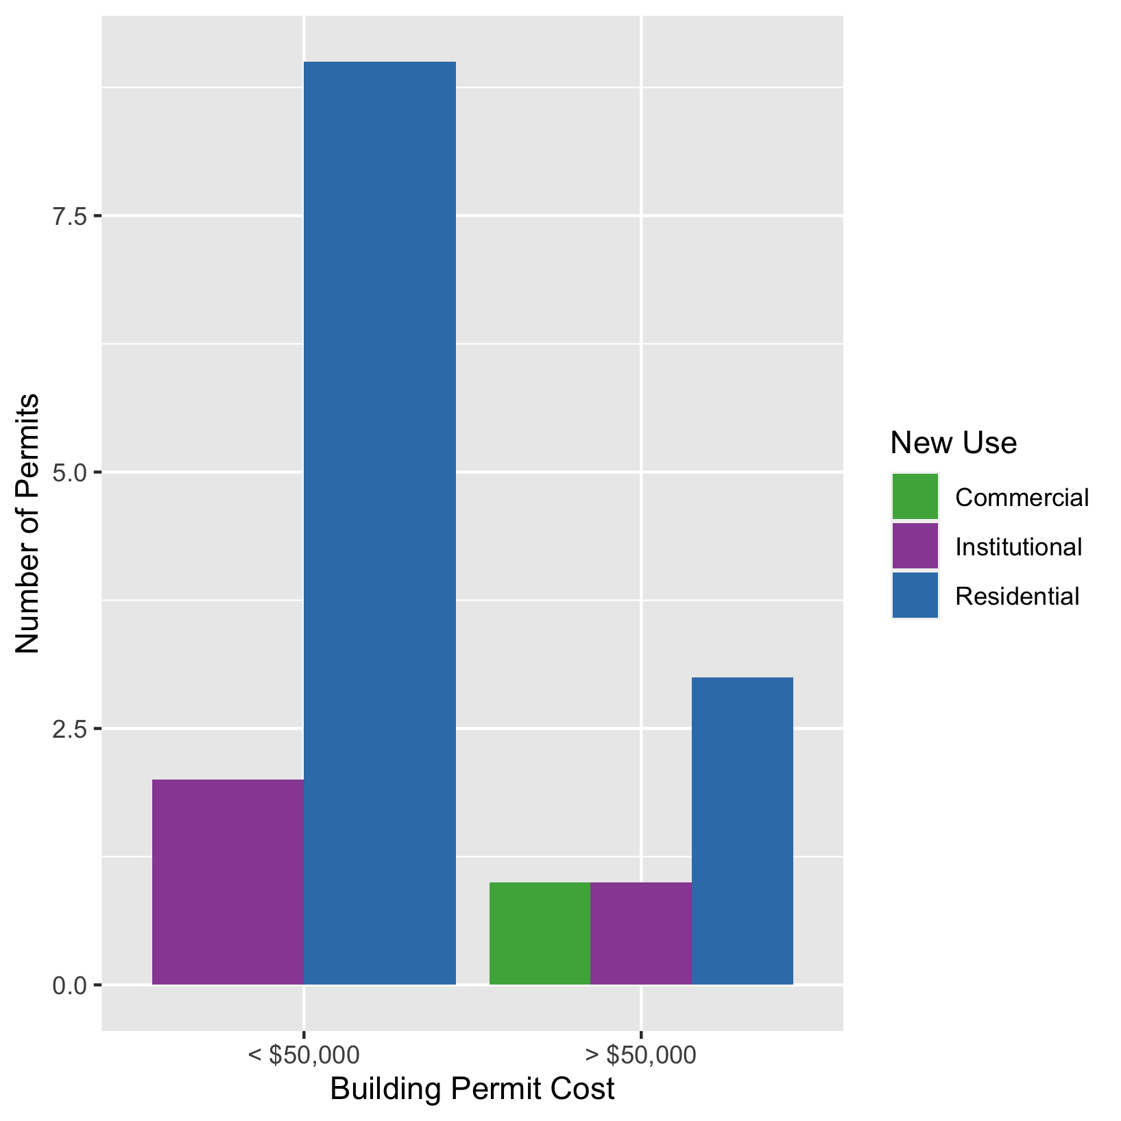
Vandeventer
New Use | Average Cost | # of Permits
Commercial | $55,000 | 1
Institutional | $28,223 | 3
Residential | $46,823 | 12

